Slide 1

ITIL 4
FOUNDATION
COURSE SLIDES · WSQ
ITIL 4 Foundation Training
WSQ Course Code: TGS-2024049350
Conducted by Tertiary Infotech Academy Pte Ltd · UEN 201200696W
Version v12.0 · 20 July 2026
© 2026 Tertiary Infotech Academy Pte Ltd. All rights reserved. · www.tertiarycourses.com.sg

Slide 2
TRAQOM · SSG DIGITAL ATTENDANCE
Digital Attendance (Mandatory)
1
2
3
4
AM attendance
▶
PM attendance
▶
Assessment
▶
75% minimum
start of each day
after lunch
before the assessment
funding eligibility
ITIL 4 Foundation Training · TGS-2024049350
© 2026 Tertiary Infotech Academy Pte Ltd · UEN 201200696W
1

Slide 3
YOUR TRAINER · GENERAL
About the Trainer
NAME
________________________________
?
TITLE / DESIGNATION
________________________________
QUALIFICATIONS
Your Trainer
________________________________
General Trainer template —
to be completed by the trainer
AREAS OF EXPERTISE
________________________________
EXPERIENCE
________________________________
CONTACT
________________________________
ITIL 4 Foundation Training · TGS-2024049350
© 2026 Tertiary Infotech Academy Pte Ltd · UEN 201200696W
2

Slide 4
YOUR TRAINER
About the Trainer
ROLE
Principal Trainer, Tertiary Infotech Academy Pte. Ltd.
AA
CERTIFICATION
ITIL 4 certified — IT service management, service operations and continual improvement.
Dr Alfred Ang
Principal Trainer
Tertiary Infotech Academy Pte Ltd
DELIVERS
WSQ courses on IT service management, IT infrastructure and IT operations.
FOUNDER
Founder and lead instructor at Tertiary Infotech / Tertiary Courses.
ITIL 4 Foundation Training · TGS-2024049350
© 2026 Tertiary Infotech Academy Pte Ltd · UEN 201200696W
3

Slide 5
ICE-BREAKER
Let's Know Each Other
1
Your name and organisation / role.
2
Your experience with IT service management or IT support (if any).
3
What you want to be able to improve in your service operations after this course.
ITIL 4 Foundation Training · TGS-2024049350
© 2026 Tertiary Infotech Academy Pte Ltd · UEN 201200696W
4

Slide 6
HOUSEKEEPING
Ground Rules
Phones on silent
Participate
Set your mobile phone to silent mode.
No question is too small.
Mutual respect
One at a time
Agree to disagree.
One conversation at a time.
Be punctual
75% attendance
Return from breaks on time.
Required for funding.
ITIL 4 Foundation Training · TGS-2024049350
© 2026 Tertiary Infotech Academy Pte Ltd · UEN 201200696W
5

Slide 7
SCHEDULE · KEY CONCEPTS OF SERVICE MANAGEMENT AND THE ITIL GUIDING PRINC
Lesson Plan — Day 1
9:30–10:00
Welcome, trainer and learner introductions, ground rules, course outline and mandatory digital…
10:00–11:00
Learning outcomes, skills framework (TSC) briefing and course overview
11:15–13:00
Topic 1 — Understand Key Concepts of Service Management: services, service management, ITIL and…
14:00–15:00
Topic 1 (continued) — service providers, consumers and the customer/user/sponsor roles; service…
15:00–16:00
Topic 1 (continued) — outputs vs outcomes, costs, risks, utility and warranty. Digital…
ITIL 4 Foundation Training · TGS-2024049350
© 2026 Tertiary Infotech Academy Pte Ltd · UEN 201200696W
6

Slide 8
SCHEDULE · THE FOUR DIMENSIONS OF SERVICE MANAGEMENT AND THE SERVICE VAL
Lesson Plan — Day 2
9:30–9:45
Day 1 recap and mandatory digital attendance (AM)
9:45–11:00
Topic 2 — ITIL Guiding Principles: the seven principles, with worked workplace examples
11:15–12:15
Hands-on: Lab 2: Lab 2 — Seven Guiding Principles and Decision Scenarios
12:15–13:00
Topic 3 — The Four Dimensions of Service Management: organizations and people, information and…
14:00–15:15
Topic 3 (continued) — partners and suppliers, value streams and processes; external factors and…
ITIL 4 Foundation Training · TGS-2024049350
© 2026 Tertiary Infotech Academy Pte Ltd · UEN 201200696W
7

Slide 9
SCHEDULE · ITIL PRACTICES, REVISION AND FINAL ASSESSMENT
Lesson Plan — Day 3
9:30–9:45
Day 2 recap and mandatory digital attendance (AM)
9:45–11:00
Topic 4 (continued) — the continual improvement model, seven steps. Hands-on: Lab 4: Lab 4 —…
11:15–13:00
Topic 5 — ITIL Practices: practice groups; continual improvement, information security,…
14:00–15:00
Topic 5 (continued) — change enablement, incident management, problem management, service…
15:00–16:00
Hands-on: Lab 5: Lab 5 — Incident, Problem, Service Request, Service Desk; Lab 6: Lab 6 —…
ITIL 4 Foundation Training · TGS-2024049350
© 2026 Tertiary Infotech Academy Pte Ltd · UEN 201200696W
8

Slide 10
WHAT YOU'LL ACHIEVE
Learning Outcomes
Key Concepts of Service Management
ITIL Guiding Principles
Services, value co-creation, outcomes, costs, risks, utility and warranty; provider and consumer roles.
The seven principles and how to apply them to real service management decisions.
Four Dimensions of Service Management
The Service Value System
Organizations and people, information and technology, partners and suppliers, value streams and processes.
The SVS, the six service value chain activities and the seven-step continual improvement model.
ITIL Practices
Incident, problem, change enablement, service request, service desk and service level management.
ITIL 4 Foundation Training · TGS-2024049350
© 2026 Tertiary Infotech Academy Pte Ltd · UEN 201200696W
9

Slide 11
SKILLS FRAMEWORK · TSC
Skills Framework Alignment
TSC: Infrastructure Support (ICT-OUS-3007-1.1)
Knowledge (K1–K6)
Abilities (A1–A8)
K1: Diagnostic tools and processes to identify technical issues or disruptions in network infrastructure
K2: Infrastructure and network configuration techniques
K3: Troubleshooting techniques for infrastructure technical issues and problems
K4: Potential benefits and impact of infrastructure upgrades
K5: Sources of information and content for user guides and materials
K6: Types of system tests and their purpose
A1: Diagnose underlying technical problems or issues causing incidents and disruptions in infrastructure and network operations
A2: Implement problem management procedures to resolve root causes of infrastructure-related incidents
A3: Provide end-to-end management of technical issues and problems encountered by users within an agreed timeframe
A4: Perform infrastructure configuration and support activities at a higher level of difficulty or complexity
A5: Develop an action plan and timeline for infrastructure upgrade activities
A6: Propose ideas for infrastructure related upgrades and improvements based on current and future user needs
A7: Test infrastructure systems in advance to assess impact of potential upgrades or updates on performance level
A8: Organise information for the development of user guides and training materials for infrastructure administration activities
ITIL 4 Foundation Training · TGS-2024049350
© 2026 Tertiary Infotech Academy Pte Ltd · UEN 201200696W
10

Slide 12
BEFORE YOU START
Briefing for Assessment
Phones away
No recording
Under the table or on the floor.
No photos of assessment scripts.
Work alone
Black or blue pen
No discussion during the assessment.
For hard-copy assessments.
No correction fluid
Pens down on time
Cross out neatly instead.
Scripts collected when time is up.
ITIL 4 Foundation Training · TGS-2024049350
© 2026 Tertiary Infotech Academy Pte Ltd · UEN 201200696W
11

Slide 13
FINAL ASSESSMENT
Assessment
Written Assessment (WA)
Case Study (CS)
Short-Answer Questions — 1 hour, open book.
Scenario-based analysis — 1 hour, open book.
Open book
Eligibility
Slides, Learner Guide and approved materials only.
75% attendance and assessed 'Competent'.
ITIL 4 Foundation Training · TGS-2024049350
© 2026 Tertiary Infotech Academy Pte Ltd · UEN 201200696W
12

Slide 14
ON ASSESSMENT DAY
Assessment Flow
1
2
3
4
5
TRAQOM survey
▶
Attendance
▶
Sit WA then CS
▶
Submit
▶
Sign off
QR on the LMS
scan the SSG QR
open book
on the LMS
Summary Record
ITIL 4 Foundation Training · TGS-2024049350
© 2026 Tertiary Infotech Academy Pte Ltd · UEN 201200696W
13

Slide 15
SSG FUNDING
Criteria for Funding
Minimum 75% attendance
Complete the assessment
Per the SSG Digital Attendance record.
Both the WA and the Case Study.
Assessed 'Competent'
TRAQOM survey
Across every assessment criterion.
Complete the mandatory survey on the LMS.
ITIL 4 Foundation Training · TGS-2024049350
© 2026 Tertiary Infotech Academy Pte Ltd · UEN 201200696W
14

Slide 16

COURSE PORTAL
Login to LMS and Download Course Material
Log in at lms-tms.tertiaryinfotech.com with your registered email and the OTP sent to your inbox, then open this course to download the slides and Learner Guide.
ITIL 4 Foundation Training · TGS-2024049350
© 2026 Tertiary Infotech Academy Pte Ltd · UEN 201200696W
15

Slide 17
COURSE PORTAL · LMS / TMS
Download Your Course Material
1
2
3
4
5
Open the portal
▶
Log in
▶
My Courses
▶
Download
▶
Keep open
lms-tms.tertiaryinfotech.com
registered email
open this course
slides + Learner Guide
open-book assessment
ITIL 4 Foundation Training · TGS-2024049350
© 2026 Tertiary Infotech Academy Pte Ltd · UEN 201200696W
16

Slide 18
01
TOPIC 01
Understand Key Concepts of Service Management
Services · Value · Outcomes, Costs and Risks · Providers and Consumers · Utility and Warranty
ITIL 4 Foundation Training · TGS-2024049350
© 2026 Tertiary Infotech Academy Pte Ltd · UEN 201200696W
17

Slide 19
TOPIC 01
Topics
1
Service Management
2
Service and relationship with Value, Outcome, Cost and Risks
3
Service Consumers, Service Providers, Users, Customer
4
Understanding Nature and Components of Value
5
Value Co-Creation
6
Understanding Service Relationships
ITIL 4 Foundation Training · TGS-2024049350
© 2026 Tertiary Infotech Academy Pte Ltd · UEN 201200696W
18

Slide 20

TOPIC 01
Services and Service Management
ITIL 4 Foundation Training · TGS-2024049350
© 2026 Tertiary Infotech Academy Pte Ltd · UEN 201200696W
19

Slide 21
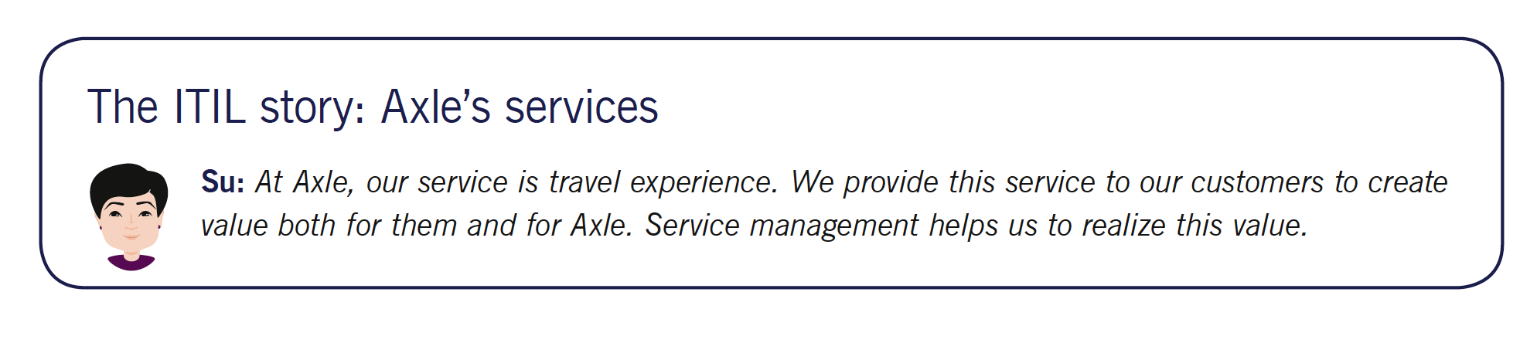
TOPIC 01
What are Services?
A service is a means of enabling value co-creation by facilitating outcomes that customers want to achieve, without the customer having to manage specific costs and risks.
ITIL 4 Foundation Training · TGS-2024049350
© 2026 Tertiary Infotech Academy Pte Ltd · UEN 201200696W
20

Slide 22
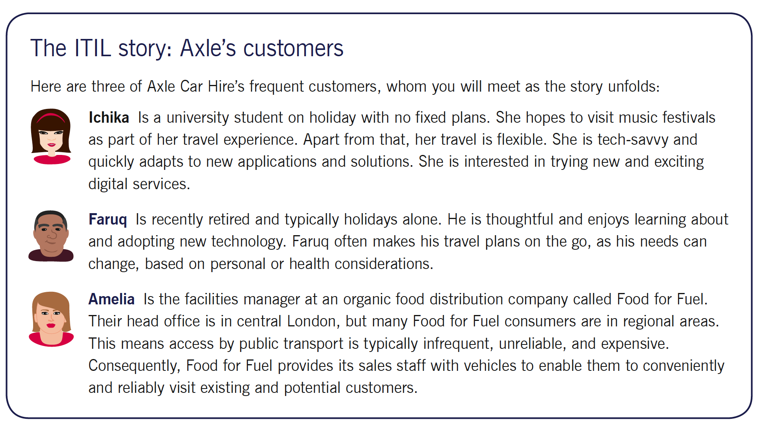
TOPIC 01
What Is a Service?
ITIL 4 Foundation Training · TGS-2024049350
© 2026 Tertiary Infotech Academy Pte Ltd · UEN 201200696W
21

Slide 23

TOPIC 01
What is IT Service Management?
Service management is a set of specialized organizational capabilities for enabling value to customers in the form of services.
ITIL 4 Foundation Training · TGS-2024049350
© 2026 Tertiary Infotech Academy Pte Ltd · UEN 201200696W
22

Slide 24

TOPIC 01
Service Value System
The purpose of the Service Value System (SVS) is to ensure that organization continually co-creates value with all stakeholders through the use and management of products and services.
ITIL 4 Foundation Training · TGS-2024049350
© 2026 Tertiary Infotech Academy Pte Ltd · UEN 201200696W
23

Slide 25

TOPIC 01
What is ITIL ?
• ITIL is a source of good practice in IT Service Management
• By good practice we mean guidance that is:
• validated across a diverse set of environments
• widely distributed.
• ITIL is not a standard
• ITIL is non-prescriptive
ITIL 4 Foundation Training · TGS-2024049350
© 2026 Tertiary Infotech Academy Pte Ltd · UEN 201200696W
24

Slide 26
TOPIC 01
The ITIL Service Value System (SVS)
1
The SVS describes how all the components and activities of an organisation work together as a system to enable value creation.
2
Inputs: OPPORTUNITY (possibilities to add value) and DEMAND (the need for services from consumers).
3
Output: VALUE — the perceived benefits, usefulness and importance of something.
4
Five components: guiding principles, governance, the service value chain, practices, and continual improvement.
5
Its purpose is to prevent organisational silos — every part must work as one system, not as separate functions.
WHY IT MATTERS
EXAM TIP
A service desk that hits its own ticket targets while releases keep breaking production is optimising a silo, not the system.
Know the five SVS components and that the two inputs are opportunity and demand.
ITIL 4 Foundation Training · TGS-2024049350
© 2026 Tertiary Infotech Academy Pte Ltd · UEN 201200696W
25

Slide 27
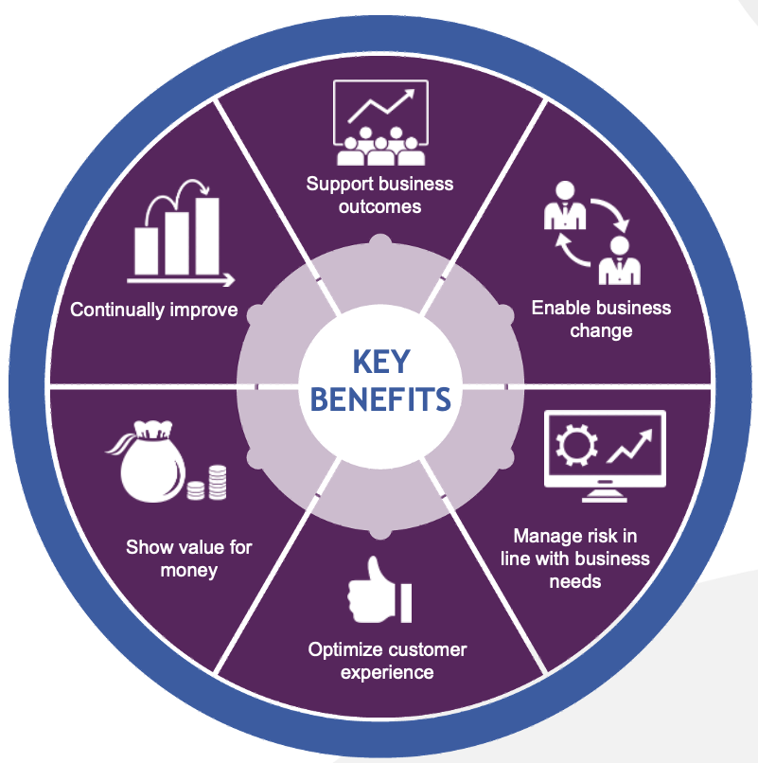
TOPIC 01
Why ITIL ?
ITIL 4 Foundation Training · TGS-2024049350
© 2026 Tertiary Infotech Academy Pte Ltd · UEN 201200696W
26

Slide 28
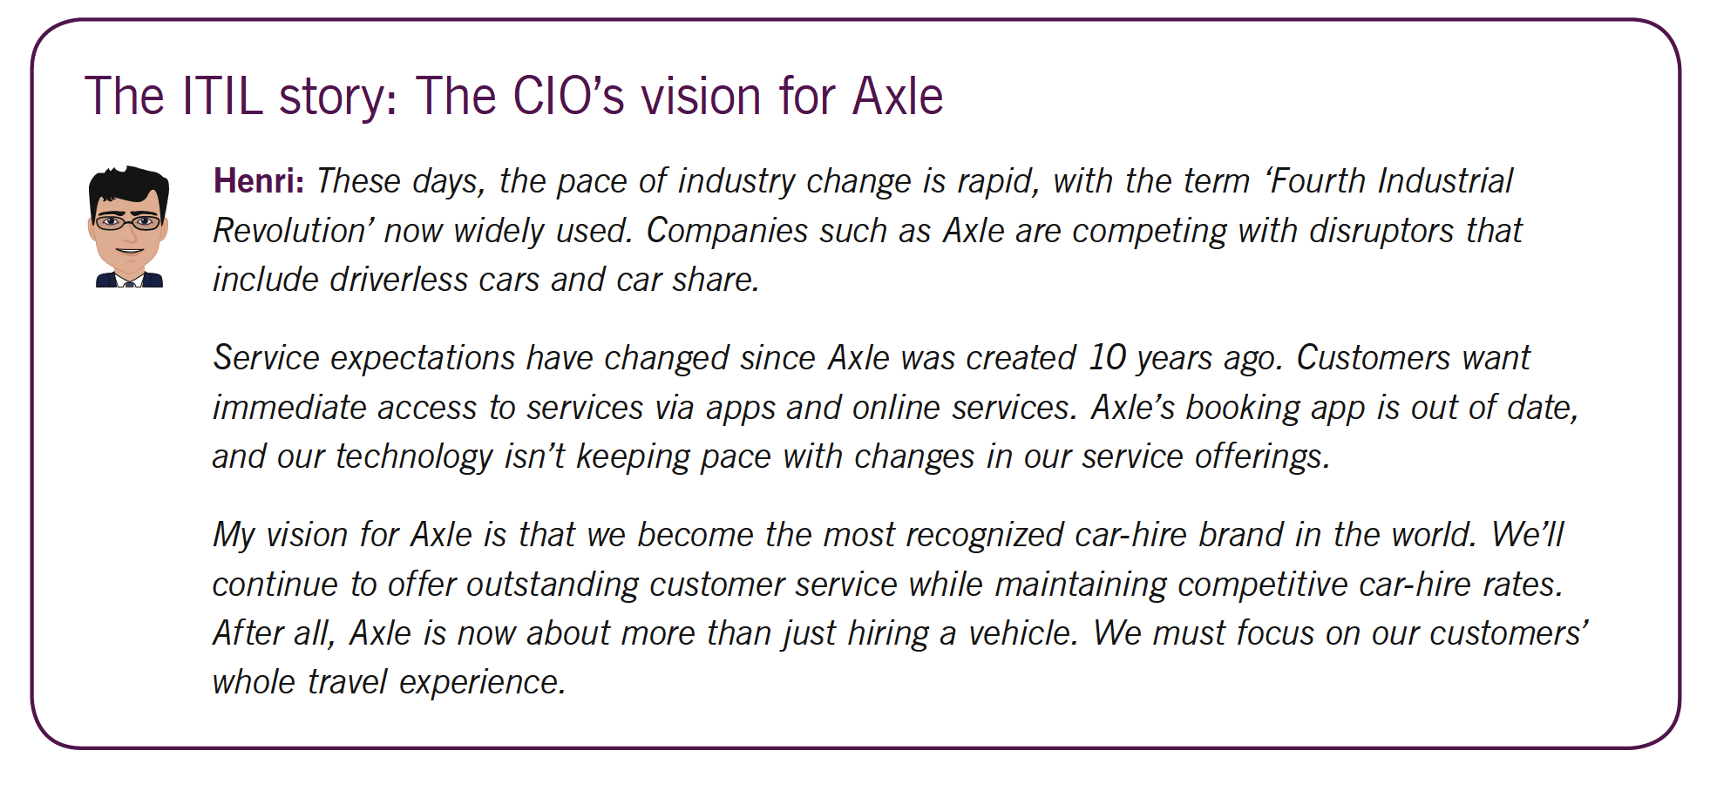
TOPIC 01
Why ITIL ?
ITIL 4 Foundation Training · TGS-2024049350
© 2026 Tertiary Infotech Academy Pte Ltd · UEN 201200696W
27

Slide 29
TOPIC 01
ITIL Versions Overview
1
ITIL Version 1 – 1986
2
Function-based practice of 40+ books dealing with a variety of IT practices developed by Central Computer and Telecommunications Agency (CCTA) in the United Kingdom.
3
ITIL Version 2 – 1999
4
Process-based practice of 10 books and the globally accepted best practice framework for IT Service Management. The most popular books were “Service Support” and “Service Delivery”.
5
ITIL Version 3 – 2007
6
Service lifecycle-based practice incorporating five lifecycle titles forming the core of ITIL practice.
7
ITIL 2011 – 2011
8
Updated for consistency and clarity.
ITIL 4 Foundation Training · TGS-2024049350
© 2026 Tertiary Infotech Academy Pte Ltd · UEN 201200696W
28

Slide 30
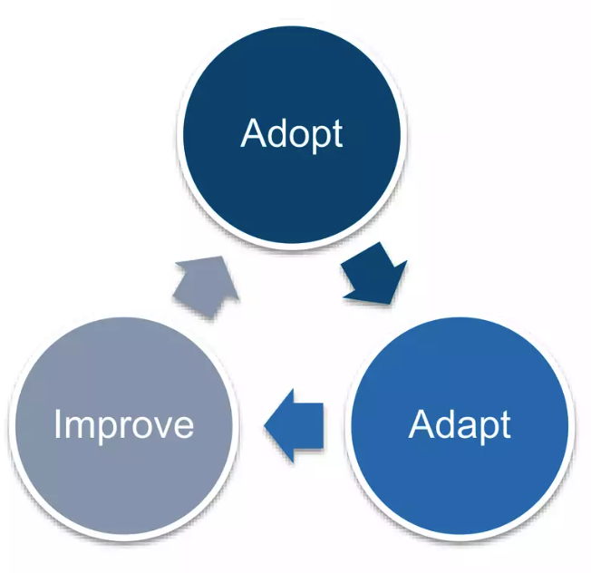
TOPIC 01
How to Use ITIL
ITIL 4 Foundation Training · TGS-2024049350
© 2026 Tertiary Infotech Academy Pte Ltd · UEN 201200696W
29

Slide 31
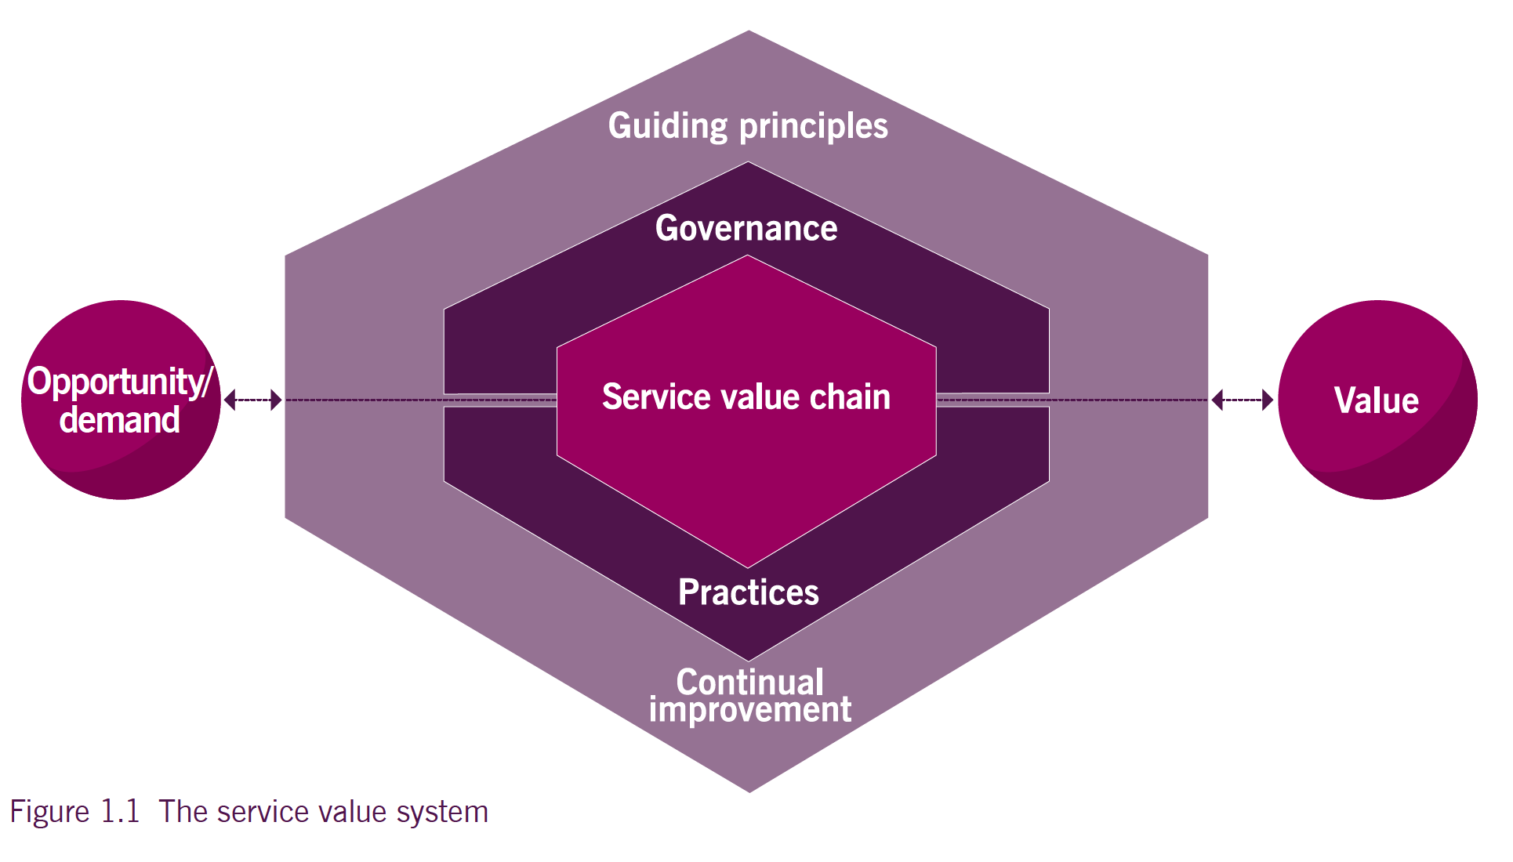
TOPIC 01
ITIL Service Value System
• Guiding principles
• Governance
• Service value chain
• Practices
• Continual improvement.
ITIL 4 Foundation Training · TGS-2024049350
© 2026 Tertiary Infotech Academy Pte Ltd · UEN 201200696W
30

Slide 32
TOPIC 01
Opportunity and Demand — the Inputs to the SVS
1
OPPORTUNITY represents options or possibilities to add value for stakeholders, or otherwise improve the organisation.
2
DEMAND is the need or desire for products and services from internal and external consumers.
3
Both trigger activities within the SVS; those activities lead to the creation of value.
4
Opportunity and demand are always entering the system — the organisation chooses which to accept.
5
Not all demand should be met, and not every opportunity should be pursued: both are filtered against strategy and capacity.
IN PRACTICE
EXAM TIP
Rising remote working (demand) plus a new cloud licensing model (opportunity) together justify a VDI service.
Exam wording: the INPUTS to the SVS are 'opportunity and demand'. Value is the OUTPUT.
ITIL 4 Foundation Training · TGS-2024049350
© 2026 Tertiary Infotech Academy Pte Ltd · UEN 201200696W
31

Slide 33
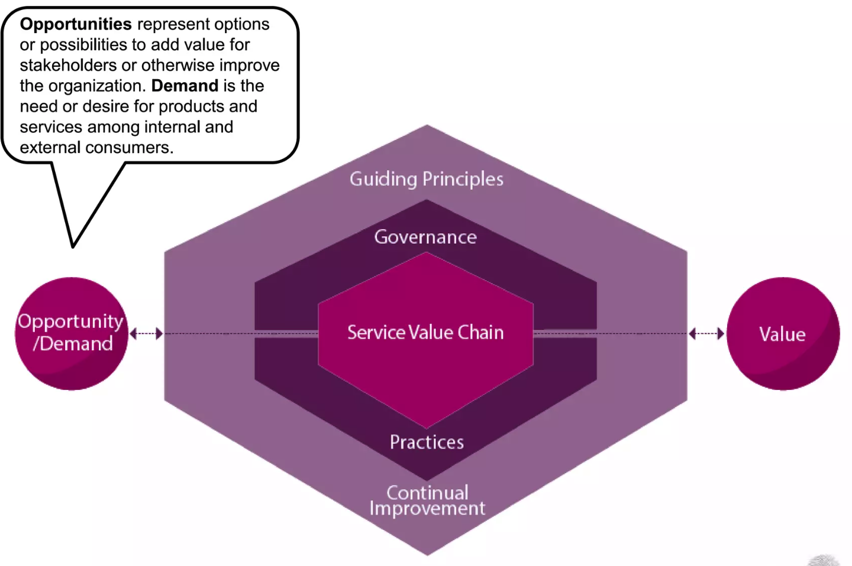
TOPIC 01
Opportunity and Demand
Opportunities represent options or possibilities to add value for stakeholders or otherwise improve the organization.
ITIL 4 Foundation Training · TGS-2024049350
© 2026 Tertiary Infotech Academy Pte Ltd · UEN 201200696W
32

Slide 34

TOPIC 01
Value
Value is the perceived benefits, usefulness, and importance of something
ITIL 4 Foundation Training · TGS-2024049350
© 2026 Tertiary Infotech Academy Pte Ltd · UEN 201200696W
33

Slide 35

TOPIC 01
The Nature of Value
ITIL 4 Foundation Training · TGS-2024049350
© 2026 Tertiary Infotech Academy Pte Ltd · UEN 201200696W
34

Slide 36
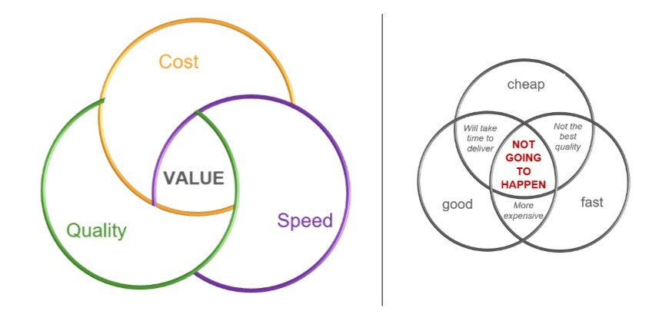
TOPIC 01
Three Dimensions of Value
ITIL 4 Foundation Training · TGS-2024049350
© 2026 Tertiary Infotech Academy Pte Ltd · UEN 201200696W
35

Slide 37
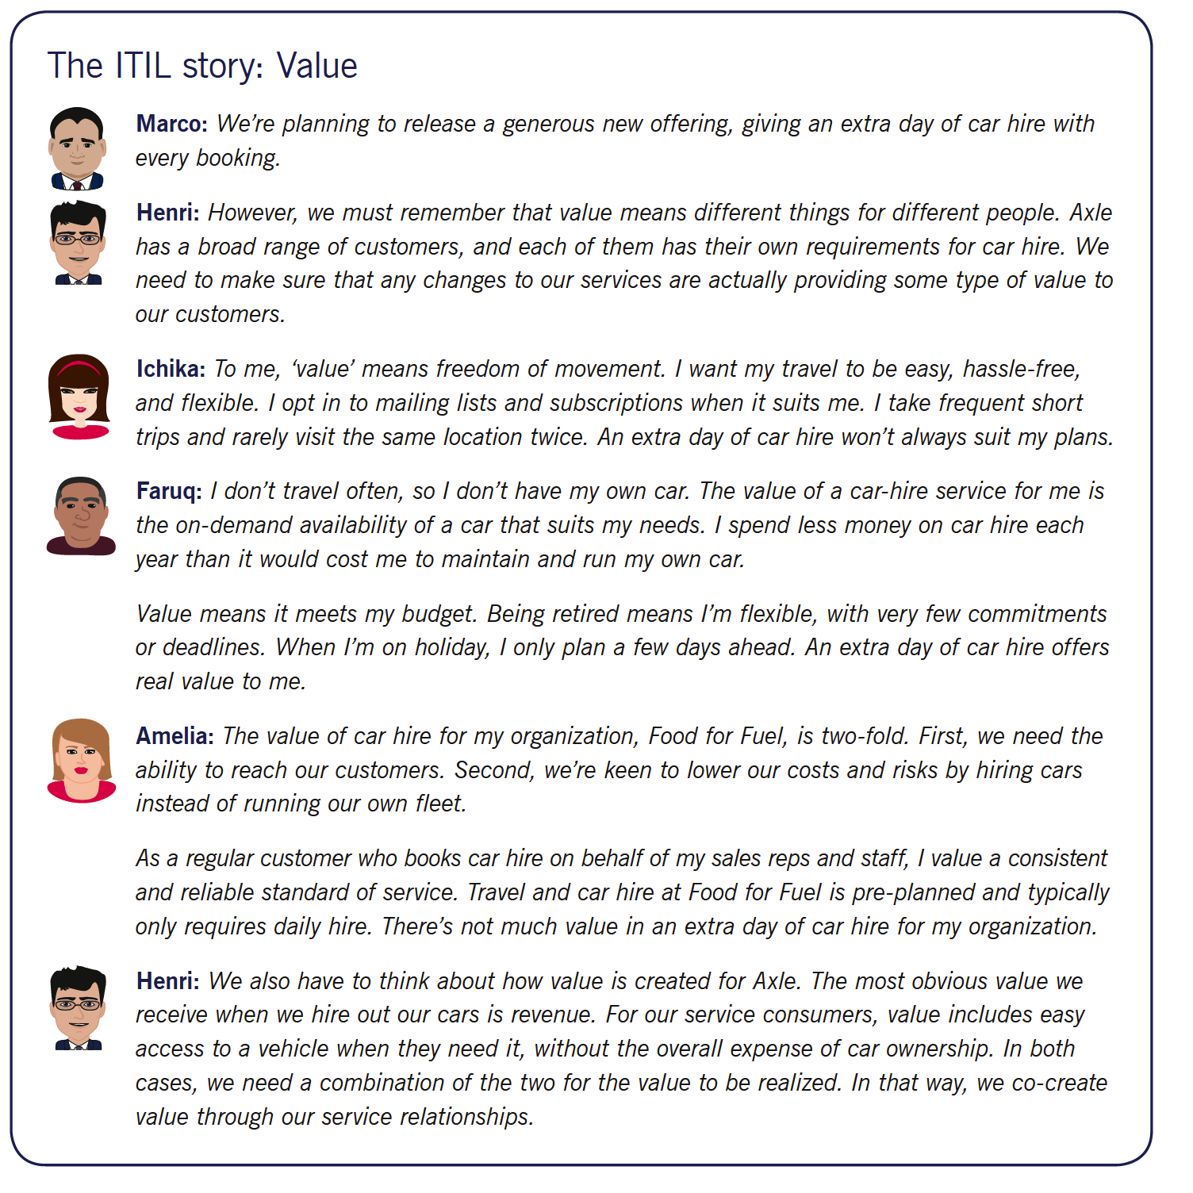
TOPIC 01
Three Dimensions of Value
ITIL 4 Foundation Training · TGS-2024049350
© 2026 Tertiary Infotech Academy Pte Ltd · UEN 201200696W
36

Slide 38
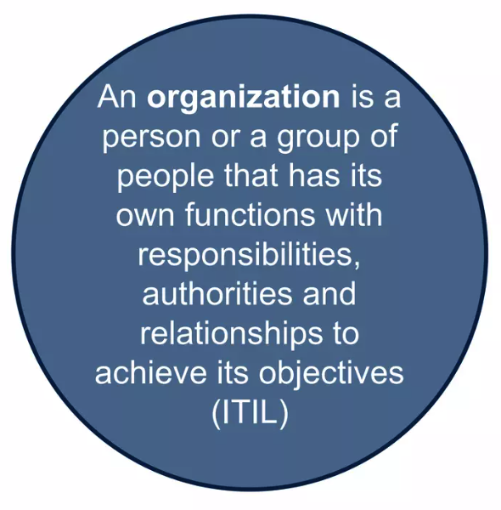
TOPIC 01
What is an Organization?
• An organization is a person or a group of people that has its functions with responsibilities, authorities, and relationships to achieve its objectives
• Organizations vary in size, complexity, and legal relationships
• Organizations: entities with functions, responsibilities, authorities, and relationships to achieve objectives
• Organizational interdependence and role variability
ITIL 4 Foundation Training · TGS-2024049350
© 2026 Tertiary Infotech Academy Pte Ltd · UEN 201200696W
37

Slide 39
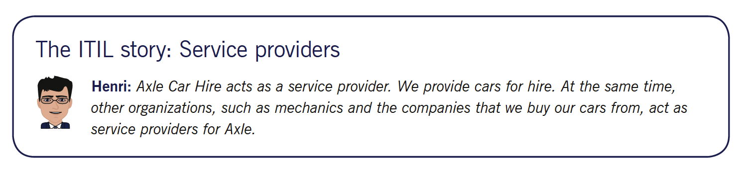
TOPIC 01
Service Providers
When provisioning services, an organization takes on the role of the service provider. The provider can be external to the consumer’s organization, or they can both be part of the same organization.
ITIL 4 Foundation Training · TGS-2024049350
© 2026 Tertiary Infotech Academy Pte Ltd · UEN 201200696W
38

Slide 40
TOPIC 01
Service Provisioning
1
Management of the provider’s resources, configured to deliver the service
2
Access to these resources for users
3
Fulfilment of the agreed-upon service actions
4
Service level management and continual improvement
5
The supplying of goods
ITIL 4 Foundation Training · TGS-2024049350
© 2026 Tertiary Infotech Academy Pte Ltd · UEN 201200696W
39

Slide 41
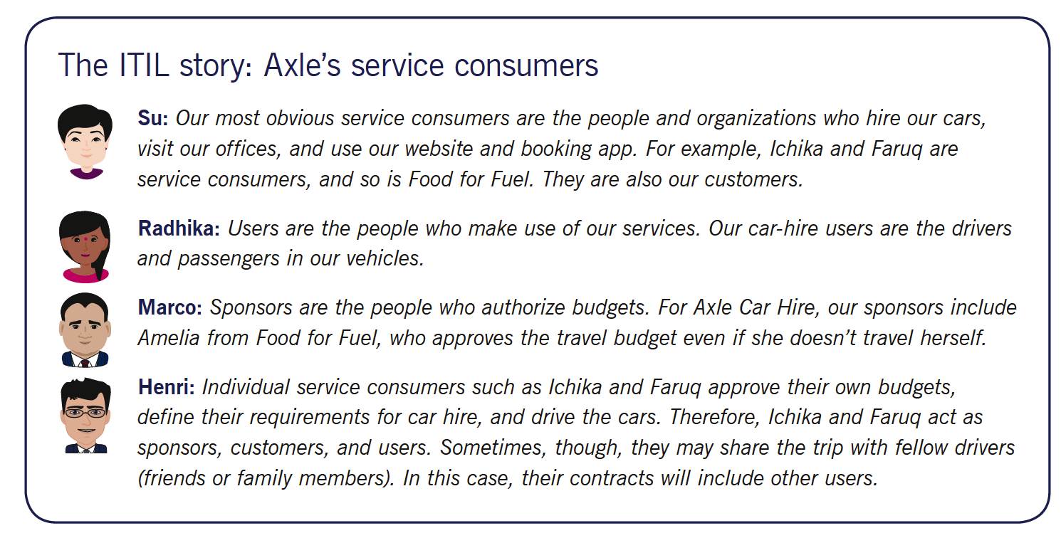
TOPIC 01
Service Consumers
When receiving services, an organization takes on the role of the service consumer.
ITIL 4 Foundation Training · TGS-2024049350
© 2026 Tertiary Infotech Academy Pte Ltd · UEN 201200696W
40

Slide 42
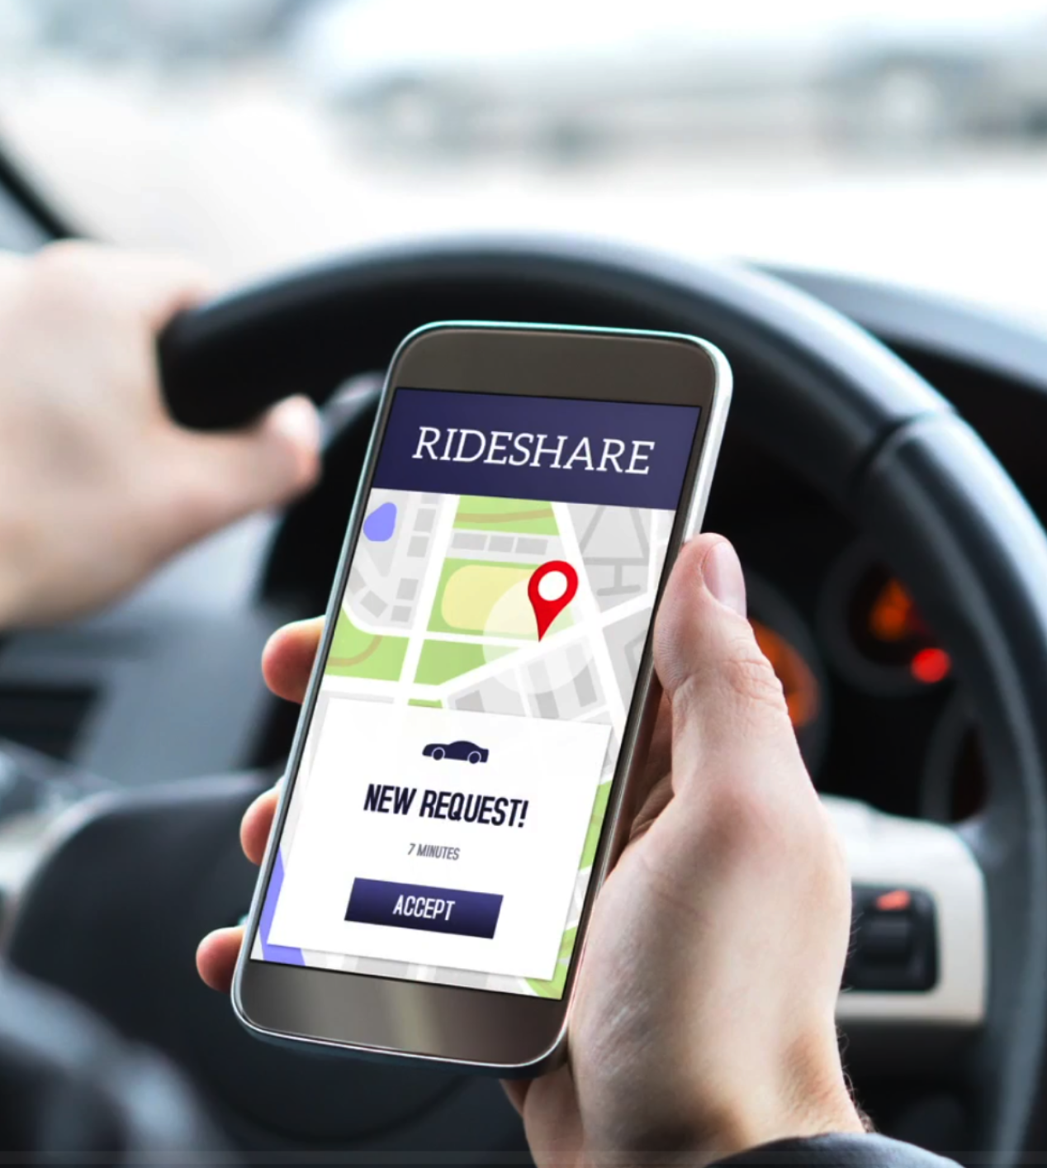
TOPIC 01
Service Consumption
• Management of the consumer’s resources needed to use the service
• Service actions performed by users, including utilitizing the provider’s resources, and requesting service actions to be fulfilled
• The receipt or acquisition of goods
ITIL 4 Foundation Training · TGS-2024049350
© 2026 Tertiary Infotech Academy Pte Ltd · UEN 201200696W
41

Slide 43
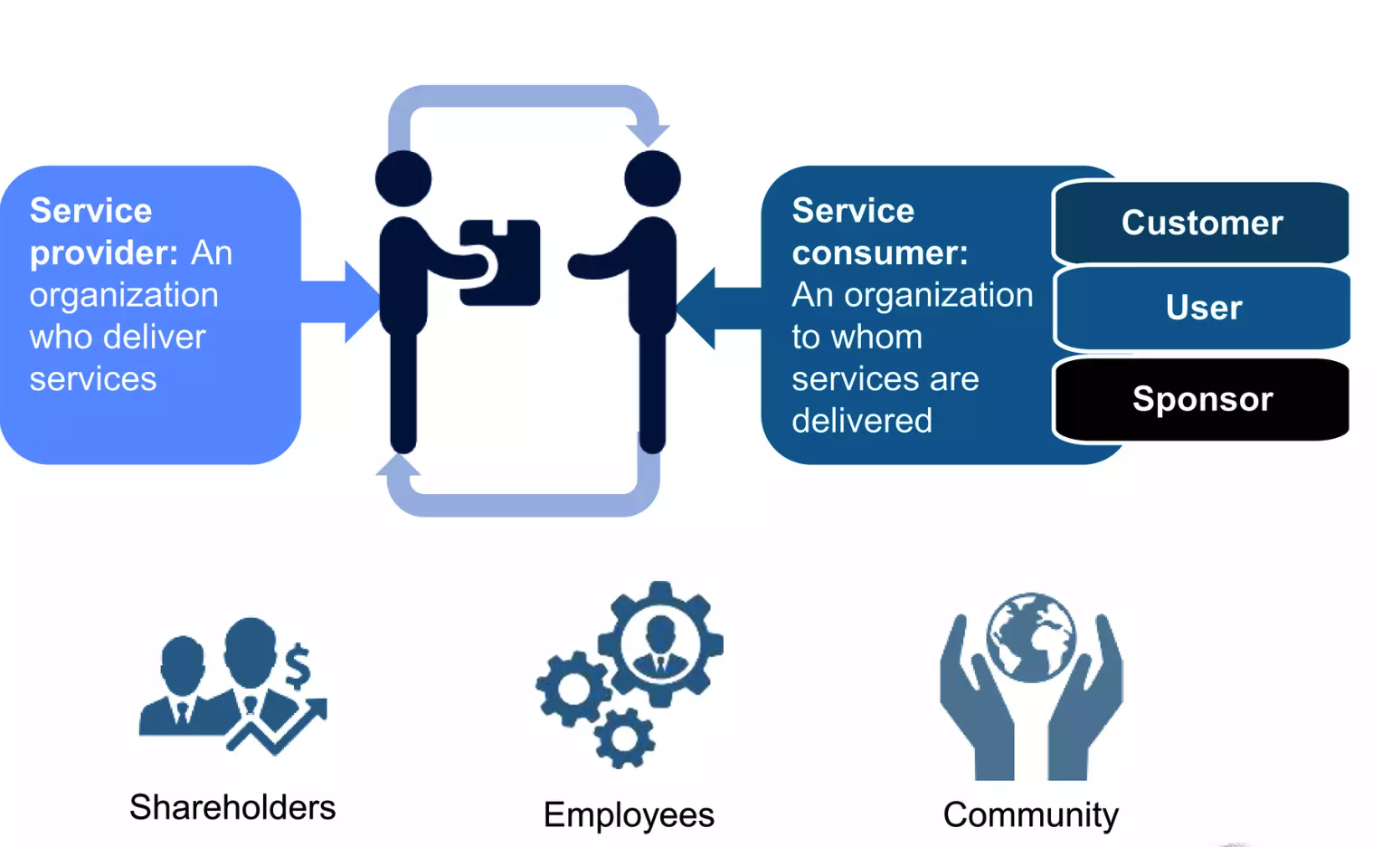
TOPIC 01
Consumers Roles
• Customer A person who defines the requirements for a service and takes responsibility for the outcomes of service consumption.
• User A person who uses services.
• Sponsor A person who authorizes budget for service consumption.
ITIL 4 Foundation Training · TGS-2024049350
© 2026 Tertiary Infotech Academy Pte Ltd · UEN 201200696W
42

Slide 44
TOPIC 01
Service Offerings
1
A service offering is a formal description of one or more services, designed to address the needs of a target consumer group.
2
It may include GOODS, ACCESS TO RESOURCES, and SERVICE ACTIONS.
3
GOODS — ownership is TRANSFERRED to the consumer, who takes responsibility for future use.
4
ACCESS TO RESOURCES — ownership is NOT transferred; access is granted or licensed under agreed terms and conditions.
5
SERVICE ACTIONS — performed by the service provider to address a consumer need, according to an agreement.
MOBILE PHONE PLAN
EXAM TIP
Goods: the handset you keep. Access to resources: the network and data allowance. Service actions: activation and support calls.
The test is ownership: transferred = goods; granted for a period = access to resources; performed by the provider = service action.
ITIL 4 Foundation Training · TGS-2024049350
© 2026 Tertiary Infotech Academy Pte Ltd · UEN 201200696W
43

Slide 45

TOPIC 01
Service vs Products
● Services: A means of enabling value co-creation by facilitating outcomes that customers want to achieve, without the customer having to manage specific costs and risks.
ITIL 4 Foundation Training · TGS-2024049350
© 2026 Tertiary Infotech Academy Pte Ltd · UEN 201200696W
44

Slide 46
TOPIC 01
Service Offering
1
Goods
2
Supplied to consumer;
3
Ownership is transferred to consumer;
4
Consumer takes responsibility for future use
5
Access to Resources
6
Ownership is not transferred to the consumer;
7
Access is granted or licensed to the consumer under agreed terms and conditions
8
The consumer can only access the resources during the agreed consumption period and according to the agreed services and terms
ITIL 4 Foundation Training · TGS-2024049350
© 2026 Tertiary Infotech Academy Pte Ltd · UEN 201200696W
45

Slide 47
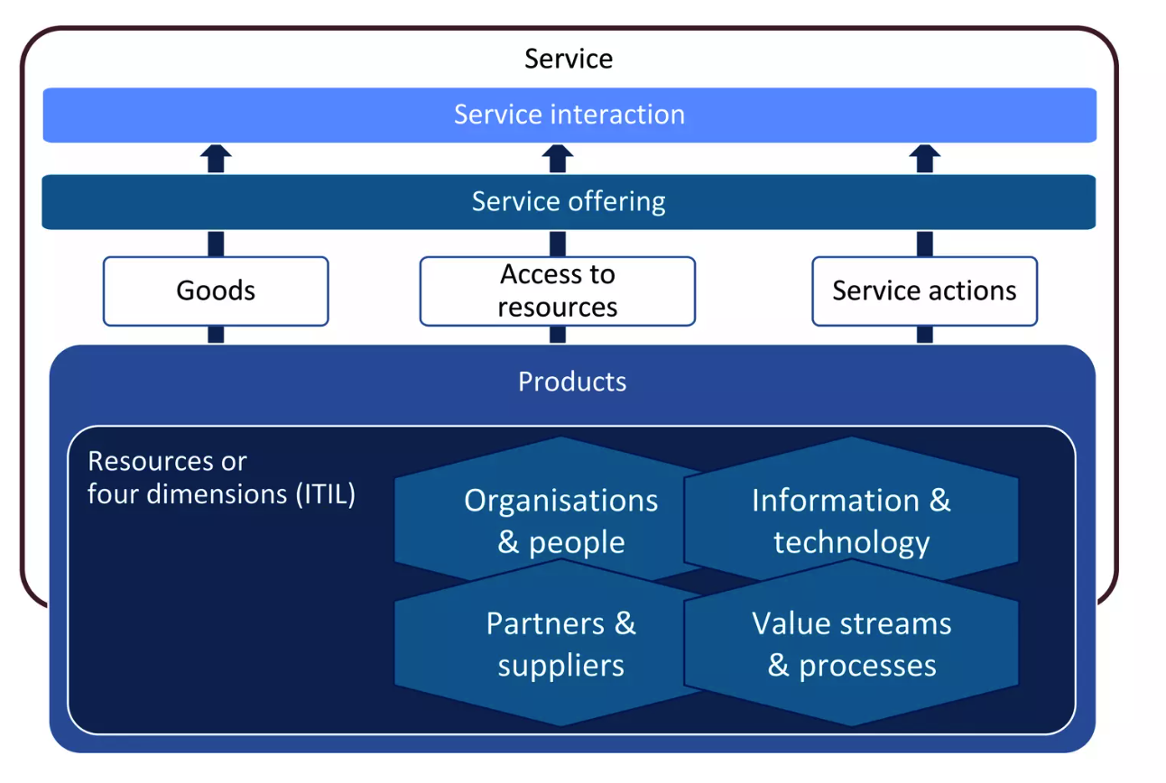
TOPIC 01
Service Offering
ITIL 4 Foundation Training · TGS-2024049350
© 2026 Tertiary Infotech Academy Pte Ltd · UEN 201200696W
46

Slide 48
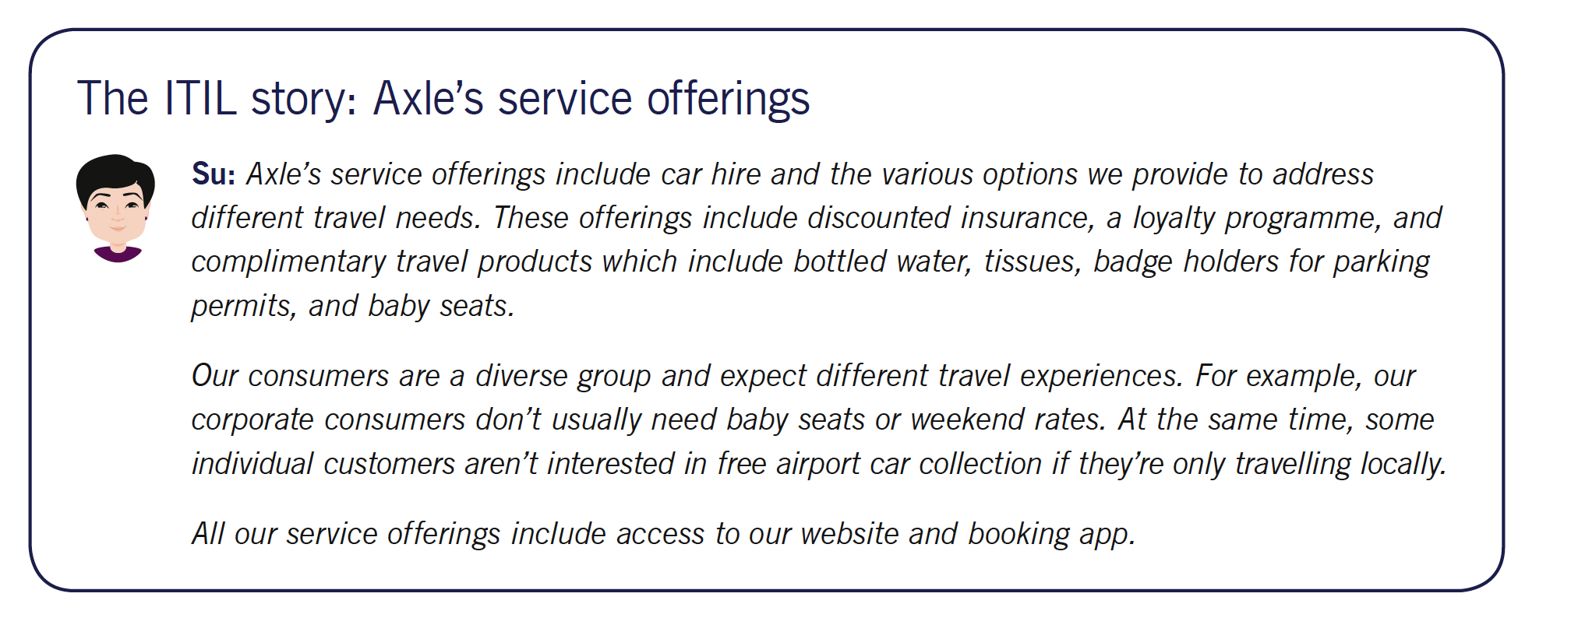
TOPIC 01
Service Offerings
ITIL 4 Foundation Training · TGS-2024049350
© 2026 Tertiary Infotech Academy Pte Ltd · UEN 201200696W
47

Slide 49
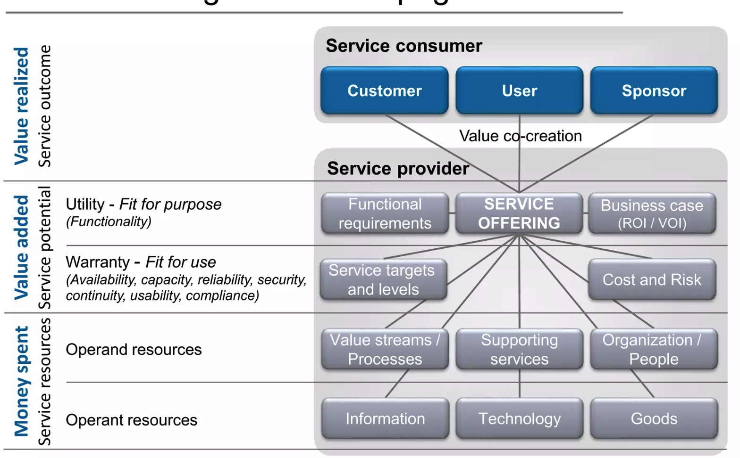
TOPIC 01
Service Offering
ITIL 4 Foundation Training · TGS-2024049350
© 2026 Tertiary Infotech Academy Pte Ltd · UEN 201200696W
48

Slide 50

TOPIC 01
Service Relationship
A service relationship is cooperation between a service provider and service consumer.
ITIL 4 Foundation Training · TGS-2024049350
© 2026 Tertiary Infotech Academy Pte Ltd · UEN 201200696W
49

Slide 51
TOPIC 01
Service Relationship
Service relationships are established between two or more organizations to co-create value. In a service relationship, organizations will take on the roles of service providers or service consumers.
ITIL 4 Foundation Training · TGS-2024049350
© 2026 Tertiary Infotech Academy Pte Ltd · UEN 201200696W
50

Slide 52
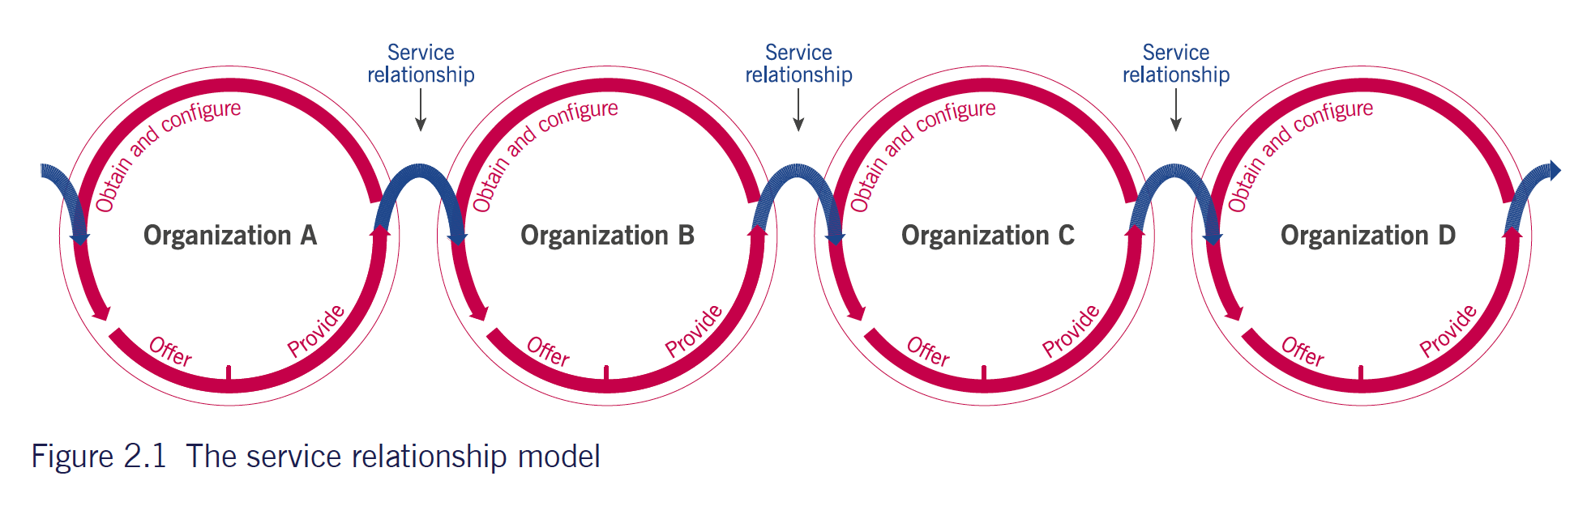
TOPIC 01
Service Relationship Model
When services are delivered by the provider, they create new resources for service consumers or modify their existing ones.
ITIL 4 Foundation Training · TGS-2024049350
© 2026 Tertiary Infotech Academy Pte Ltd · UEN 201200696W
51

Slide 53
TOPIC 01
Resources, Cost and Risk
1
A RESOURCE is personnel, material, finance or any other entity required to execute an activity or achieve an objective.
2
Resources used by an organisation may be owned by it, or used under agreement with their owner.
3
Service relationships shift the burden of certain resources from the consumer to the provider.
4
This is precisely how a service removes cost and risk from the consumer — the provider carries them instead.
5
The consumer still manages the resources it needs in order to CONSUME the service.
CLOUD HOSTING
EXAM TIP
The provider owns the data centre, hardware and patching; the consumer keeps only the skills to use the platform.
Resources are the 'what you need to do the work'. Do not confuse them with the service actions performed with them.
ITIL 4 Foundation Training · TGS-2024049350
© 2026 Tertiary Infotech Academy Pte Ltd · UEN 201200696W
52

Slide 54
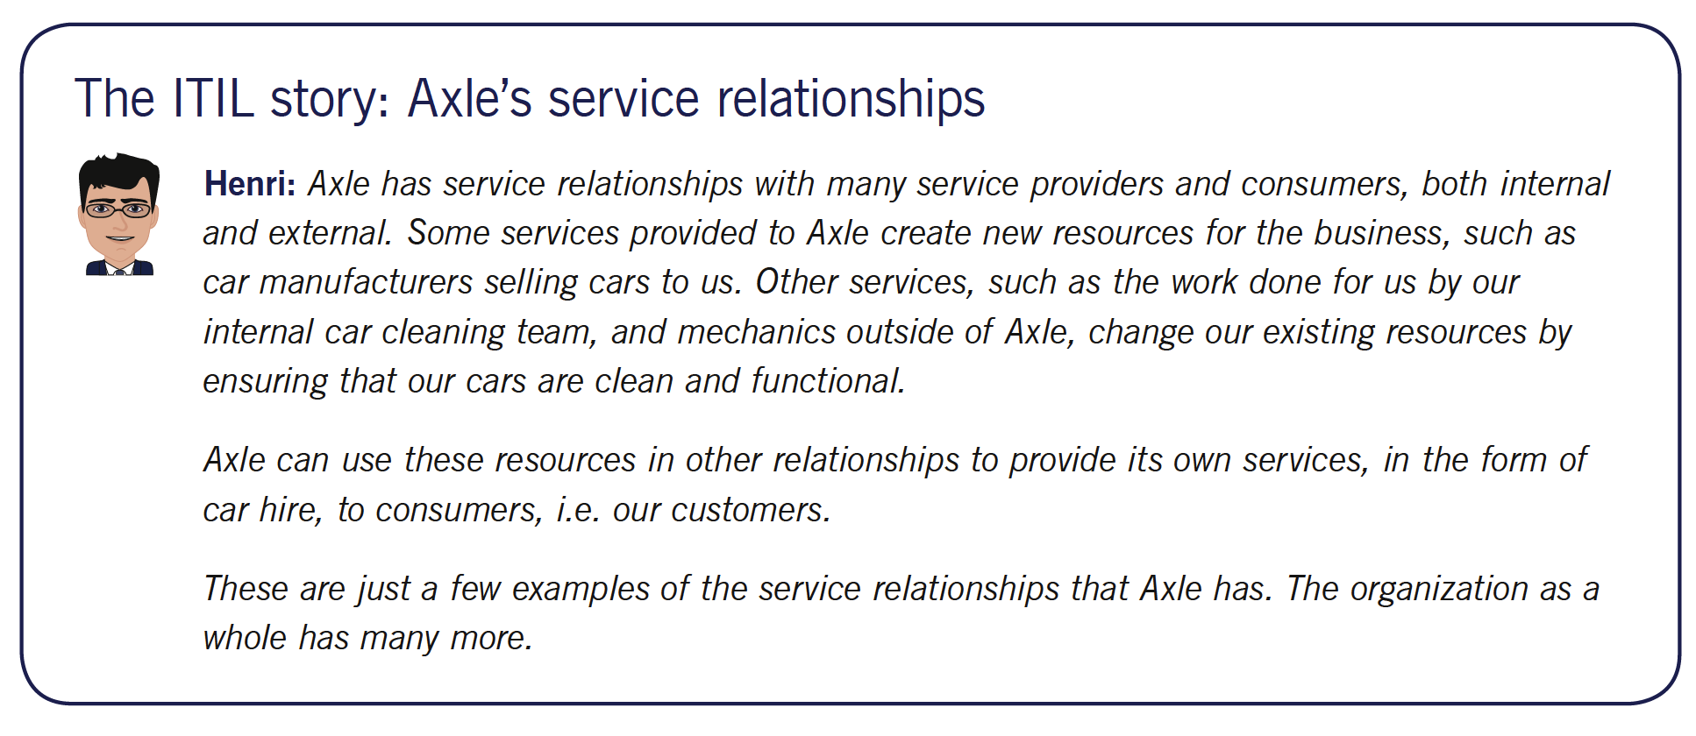
TOPIC 01
Service Relationship Model
ITIL 4 Foundation Training · TGS-2024049350
© 2026 Tertiary Infotech Academy Pte Ltd · UEN 201200696W
53

Slide 55
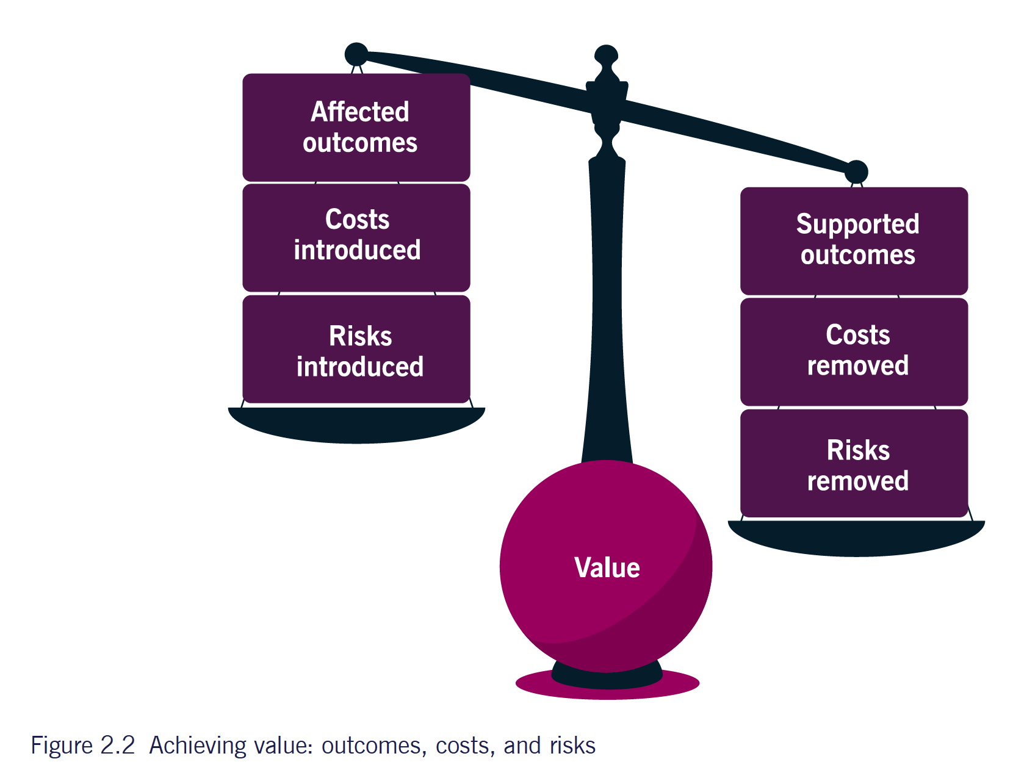
TOPIC 01
Service Value - Outcomes, Costs and Risks
ITIL 4 Foundation Training · TGS-2024049350
© 2026 Tertiary Infotech Academy Pte Ltd · UEN 201200696W
54

Slide 56
TOPIC 01
Output vs Outcome
Output
Outcome
• Output:
• A tangible or intangible deliverable of an activity.
• Example: delivery of a package or completed task
• Outcome:
• A result for a stakeholder enabled by one or more outputs.
• Example: ability to print a report due to delivered equipment
• Key distinction:
• Outputs are deliverables from activities
• Outcomes are benefits or results gained from outputs
ITIL 4 Foundation Training · TGS-2024049350
© 2026 Tertiary Infotech Academy Pte Ltd · UEN 201200696W
55

Slide 57
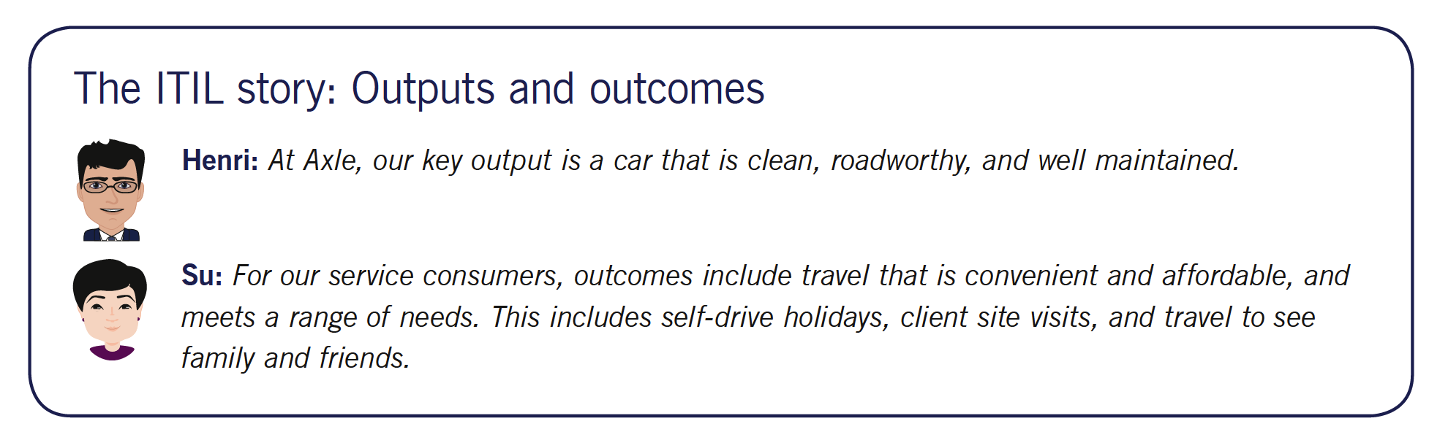
TOPIC 01
Output vs Outcome
ITIL 4 Foundation Training · TGS-2024049350
© 2026 Tertiary Infotech Academy Pte Ltd · UEN 201200696W
56

Slide 58
TOPIC 01
Costs in a Service Relationship
1
COST is the amount of money spent on a specific activity or resource; it can also be expressed non-monetarily, as time or effort.
2
Every service both IMPOSES costs on the consumer and REMOVES costs from the consumer.
3
Costs IMPOSED: the fees, charges and effort of adopting and using the service.
4
Costs REMOVED: the infrastructure, staff, training and maintenance the consumer no longer has to fund.
5
A service is worth adopting when the costs removed plus the outcomes enabled exceed the costs imposed.
PAYROLL SAAS
EXAM TIP
Imposes a subscription and migration effort; removes a payroll server, an in-house specialist and quarterly compliance updates.
Expect a question that asks which costs a service REMOVES — the answer is the consumer's own infrastructure and effort.
ITIL 4 Foundation Training · TGS-2024049350
© 2026 Tertiary Infotech Academy Pte Ltd · UEN 201200696W
57

Slide 59
TOPIC 01
Types of Cost — Imposed and Removed
1
Costs IMPOSED on the consumer: the fees, charges and expenses of adopting and using the service.
2
Also imposed: migration effort, training time, and the cost of integrating the service with existing systems.
3
Costs REMOVED from the consumer: the infrastructure, licences, premises and staff no longer needed.
4
Also removed: the effort of maintenance, patching, capacity planning and specialist recruitment.
5
Adoption is justified when the costs removed, plus the outcomes enabled, outweigh the costs imposed.
BOTH DIRECTIONS AT ONCE
EXAM TIP
Moving email to a cloud suite imposes per-seat fees; it removes mail servers, backups and an administrator.
Every service does BOTH. A question naming only one direction is testing whether you know the other exists.
ITIL 4 Foundation Training · TGS-2024049350
© 2026 Tertiary Infotech Academy Pte Ltd · UEN 201200696W
58

Slide 60

TOPIC 01
Risks
A possible event that could cause harm or loss, or make it more difficult to achieve objectives.
ITIL 4 Foundation Training · TGS-2024049350
© 2026 Tertiary Infotech Academy Pte Ltd · UEN 201200696W
59

Slide 61
TOPIC 01
Risks in a Service Relationship
1
A RISK is a possible event that could cause harm or loss, or make it more difficult to achieve objectives.
2
Risk can also be defined as uncertainty of outcome, and can be used to measure both positive and negative uncertainty.
3
Like cost, a service both IMPOSES and REMOVES risk for the consumer.
4
Risks IMPOSED: service outages, security exposure, supplier lock-in, compliance gaps.
5
Risks REMOVED: the consumer no longer carries hardware failure, capacity planning or specialist staff turnover.
MANAGED SECURITY
EXAM TIP
Removes the risk of missing a critical patch; imposes the risk of depending on the provider's own response times.
A service NEVER removes all risk. Foundation questions test that both directions exist.
ITIL 4 Foundation Training · TGS-2024049350
© 2026 Tertiary Infotech Academy Pte Ltd · UEN 201200696W
60

Slide 62
TOPIC 01
Utility and Warranty
1
UTILITY is the functionality offered by a product or service to meet a particular need — 'what the service DOES'.
2
Utility determines whether a service is FIT FOR PURPOSE.
3
To have utility, a service must either support the performance of the consumer, or remove constraints from the consumer — many do both.
4
WARRANTY is the assurance that a product or service will meet agreed requirements — 'how the service PERFORMS'.
5
Warranty determines whether a service is FIT FOR USE, and covers availability, capacity, security and continuity.
6
A service needs BOTH to create value: functionality nobody can reach delivers nothing.
HOTEL ROOM
EXAM TIP
Utility: a bed, wifi and a desk. Warranty: the room is available on the night booked, and the door lock works.
Utility = fit for PURPOSE = what it does. Warranty = fit for USE = how it performs. Both are needed.
ITIL 4 Foundation Training · TGS-2024049350
© 2026 Tertiary Infotech Academy Pte Ltd · UEN 201200696W
61

Slide 63
TOPIC 01
Utility vs Warranty
Utility
Warranty
• Utility
• What the service does - fit for purpose
• Functionality offered to meet a need
• Examples:
• Access to:
• Bed
• Internet connection
• Food
• Warranty
ITIL 4 Foundation Training · TGS-2024049350
© 2026 Tertiary Infotech Academy Pte Ltd · UEN 201200696W
62

Slide 64

TOPIC 01
Utility vs Warranty
Utility focuses on the functionality and ensuring that the service meets the needs and purposes of the consumer.
ITIL 4 Foundation Training · TGS-2024049350
© 2026 Tertiary Infotech Academy Pte Ltd · UEN 201200696W
63

Slide 65
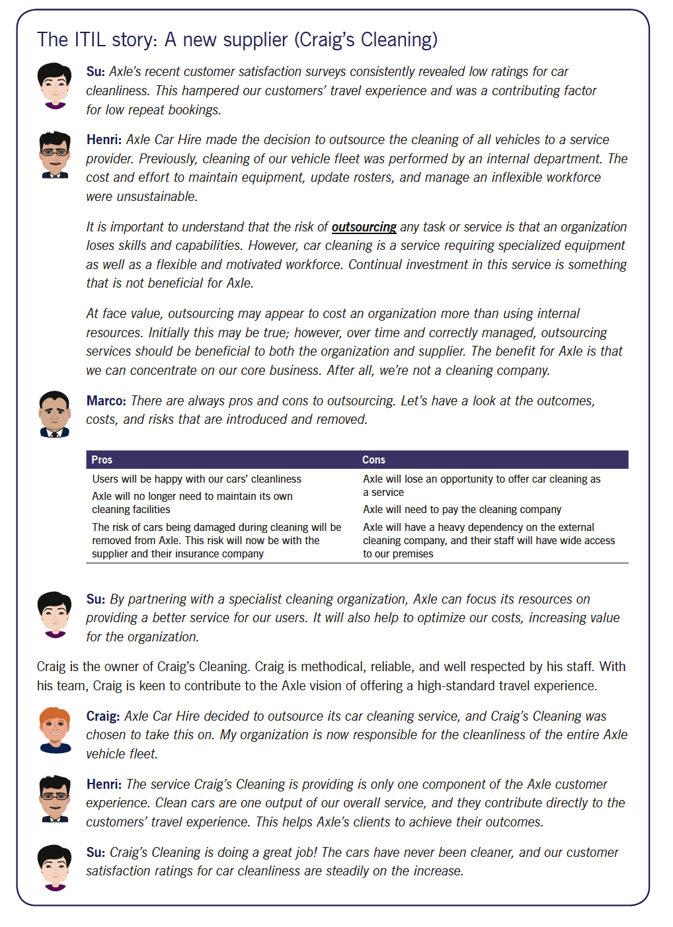
TOPIC 01
From Utility and Warranty to the Service Value Chain
ITIL 4 Foundation Training · TGS-2024049350
© 2026 Tertiary Infotech Academy Pte Ltd · UEN 201200696W
64

Slide 66
TOPIC 01
The Service Value Chain
1
The service value chain is an operating model: a set of six interconnected activities an organisation performs to deliver a valuable product or service.
2
The six activities are PLAN, IMPROVE, ENGAGE, DESIGN AND TRANSITION, OBTAIN/BUILD, and DELIVER AND SUPPORT.
3
Each activity converts inputs into outputs; the outputs of one commonly become the inputs of another.
4
The activities can be combined in many sequences — these combinations are called VALUE STREAMS.
5
The chain is flexible by design: no fixed order is prescribed, so it adapts to any type of demand.
ONE VALUE STREAM
EXAM TIP
An incident enters at 'engage', is resolved by 'deliver and support', and a fix is fed to 'improve'.
Learn all six activity names and the PURPOSE sentence of each — they are examined directly.
ITIL 4 Foundation Training · TGS-2024049350
© 2026 Tertiary Infotech Academy Pte Ltd · UEN 201200696W
65

Slide 67
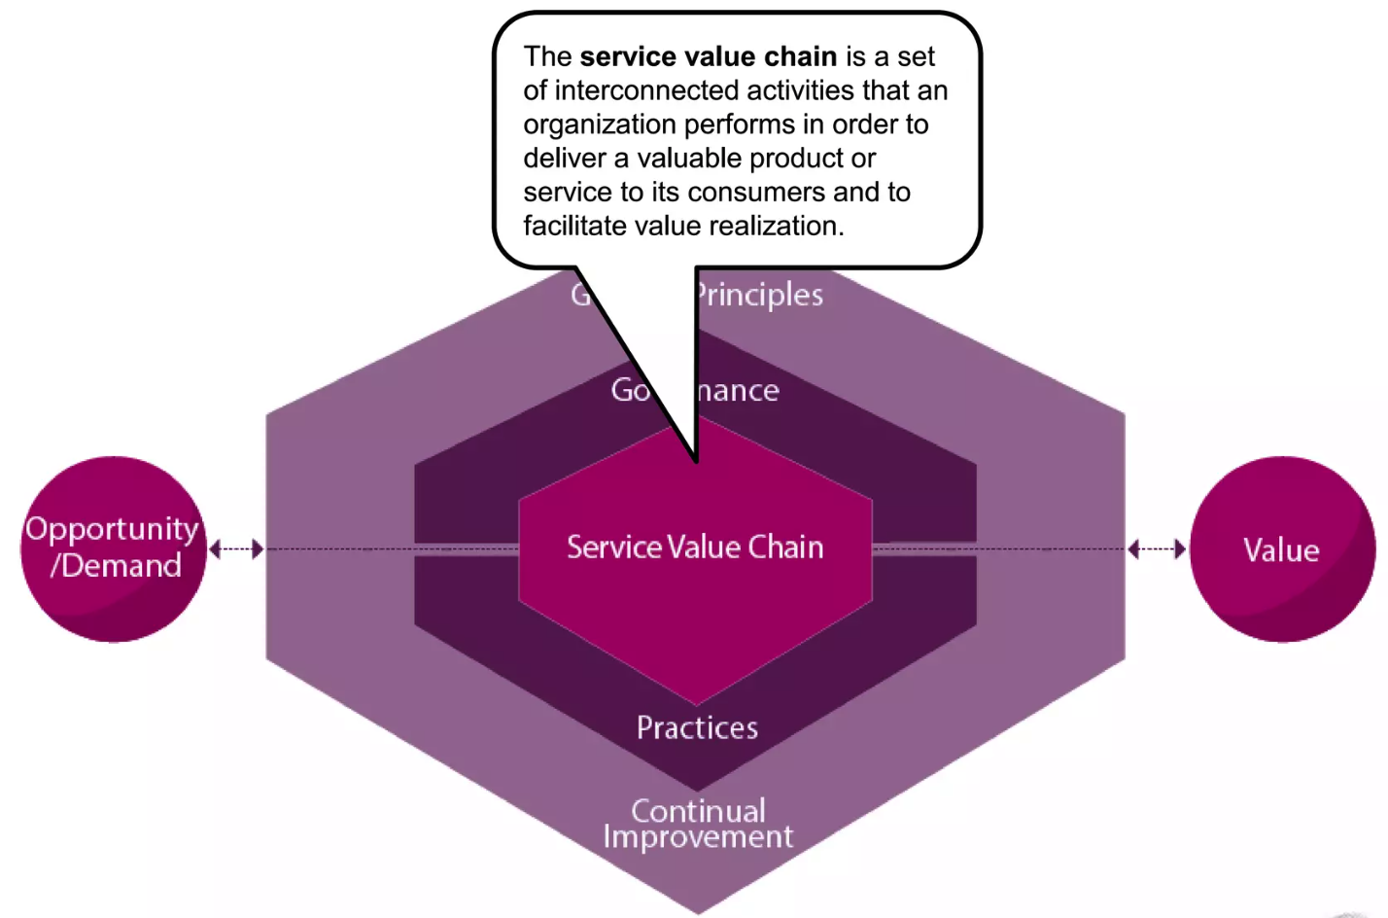
TOPIC 01
Service Value Chain
ITIL 4 Foundation Training · TGS-2024049350
© 2026 Tertiary Infotech Academy Pte Ltd · UEN 201200696W
66

Slide 68
TOPIC 01
Service Value Chain Activities
1
Plan
2
Improve
3
Engage
4
Design and transition
5
Obtain/build
6
Deliver and support.
ITIL 4 Foundation Training · TGS-2024049350
© 2026 Tertiary Infotech Academy Pte Ltd · UEN 201200696W
67

Slide 69
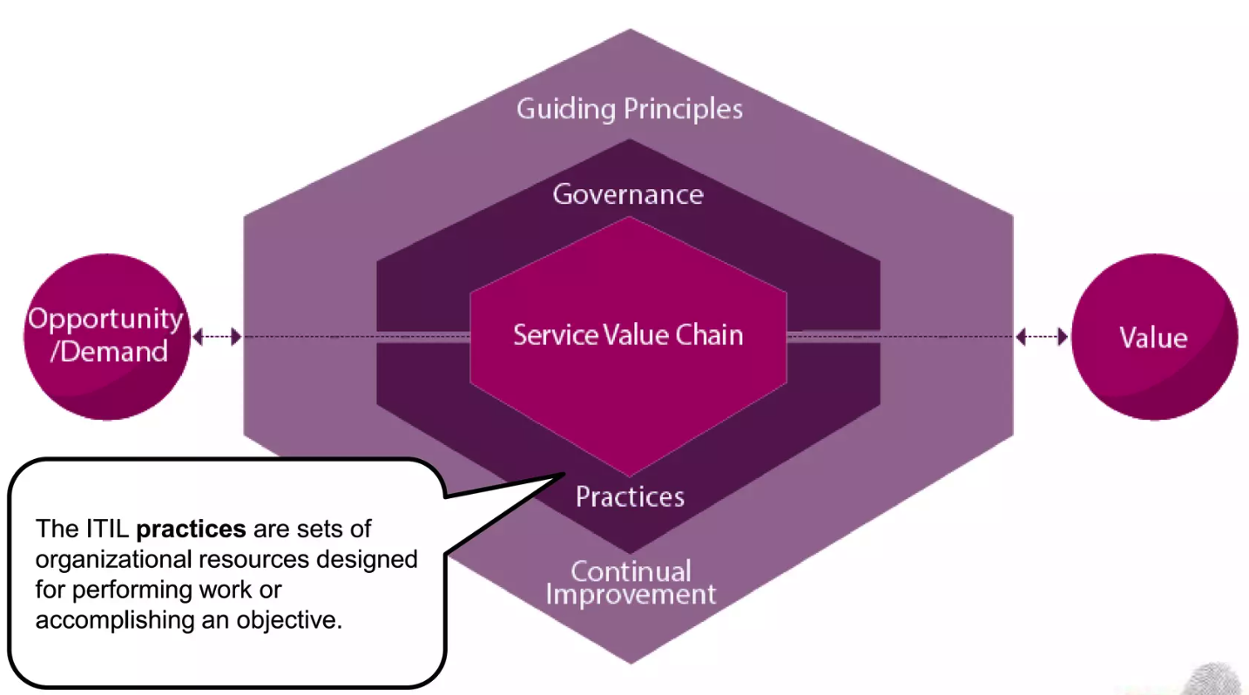
TOPIC 01
Practices
The 34 practices are set of organization resources designed for performing work or accomplishing an objective.
ITIL 4 Foundation Training · TGS-2024049350
© 2026 Tertiary Infotech Academy Pte Ltd · UEN 201200696W
68

Slide 70
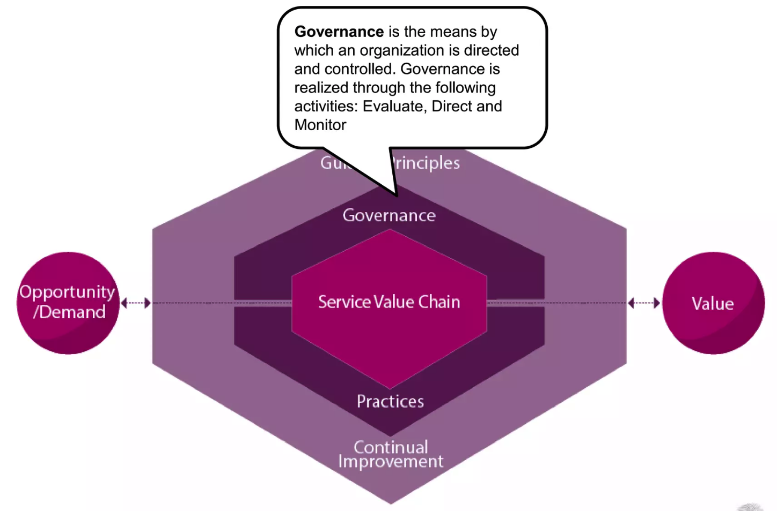
TOPIC 01
Governance
Governance is the means by which an organization is directed and controlled.
ITIL 4 Foundation Training · TGS-2024049350
© 2026 Tertiary Infotech Academy Pte Ltd · UEN 201200696W
69

Slide 71
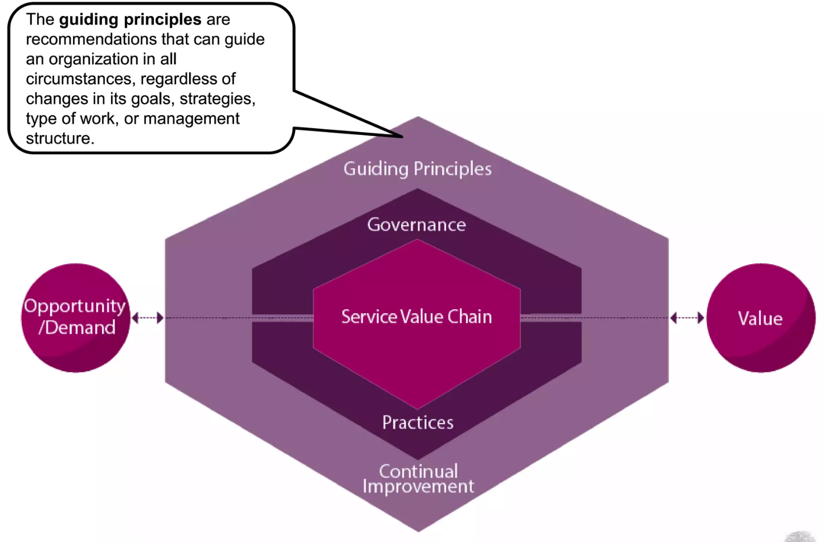
TOPIC 01
Guiding Principles
Guiding principles are recommendations that can guide an organization in all circumstances, regardless of changes in its goals, strategies, type of work, or management.
ITIL 4 Foundation Training · TGS-2024049350
© 2026 Tertiary Infotech Academy Pte Ltd · UEN 201200696W
70

Slide 72
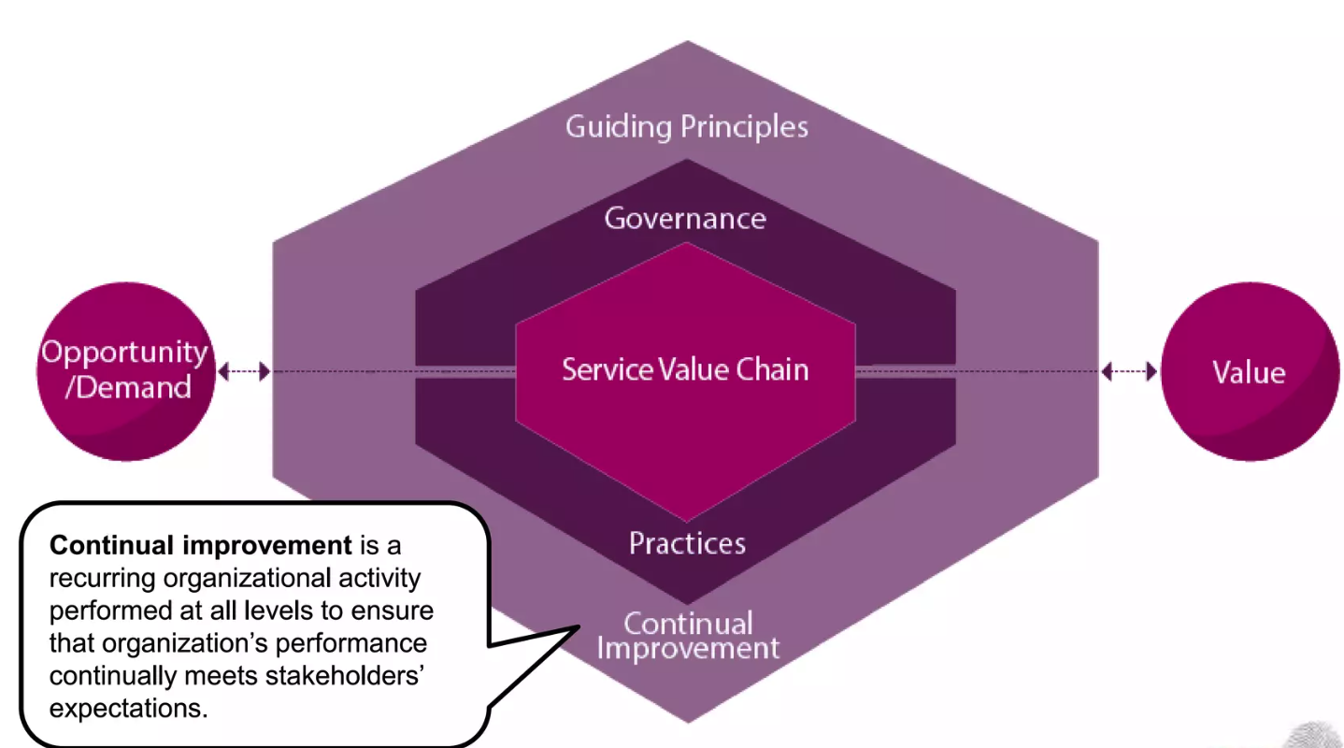
TOPIC 01
Continual Improvement
Continual improvement is a recurring organizational activity performed at all levels to ensure that an organization’s performance continually meets stakeholders’ expectations.
ITIL 4 Foundation Training · TGS-2024049350
© 2026 Tertiary Infotech Academy Pte Ltd · UEN 201200696W
71

Slide 73
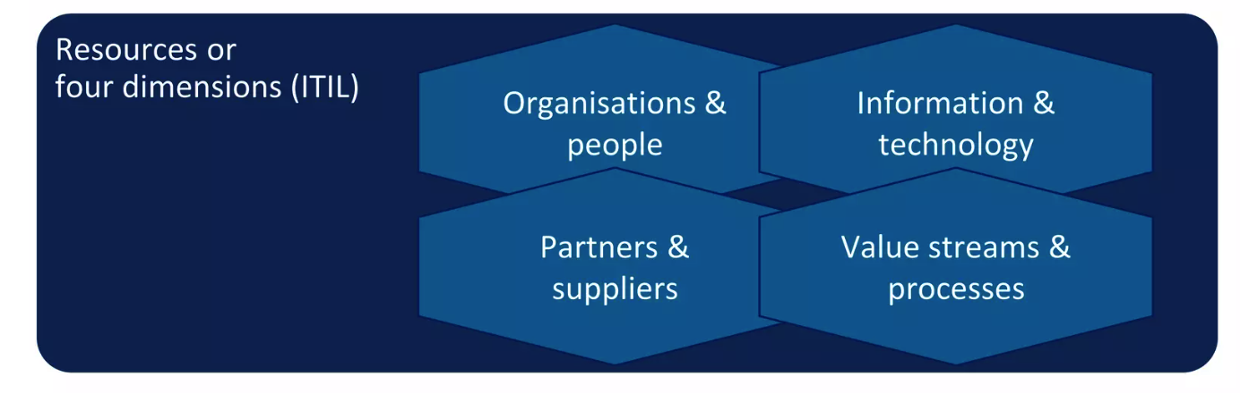
TOPIC 01
Four Dimensions of ITSM
To ensure a holistic approach to service management, ITIL 4 outlines four dimensions of service management, from which each component of the SVS should be considered.
ITIL 4 Foundation Training · TGS-2024049350
© 2026 Tertiary Infotech Academy Pte Ltd · UEN 201200696W
72

Slide 74
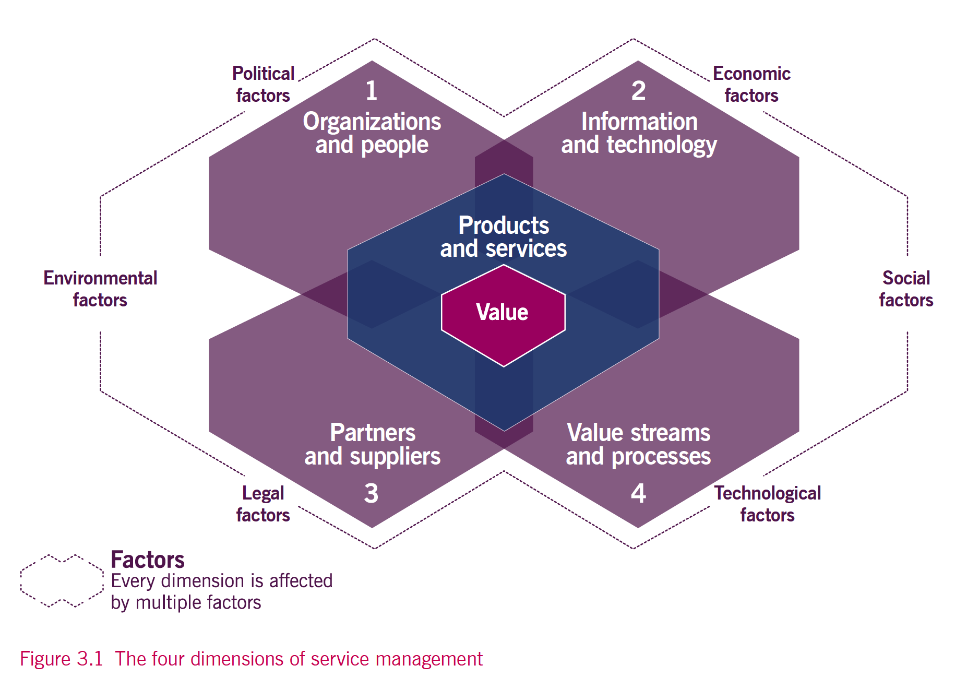
TOPIC 01
Four Dimensions of ITSM
ITIL 4 Foundation Training · TGS-2024049350
© 2026 Tertiary Infotech Academy Pte Ltd · UEN 201200696W
73

Slide 75

TOPIC 01
External Factors
Service providers do not operate in isolation. They are affected by many external factors, and work in dynamic and complex environments that can exhibit high degrees of volatility and uncertainty that impose constraints on how the service provider can work.
ITIL 4 Foundation Training · TGS-2024049350
© 2026 Tertiary Infotech Academy Pte Ltd · UEN 201200696W
74

Slide 76
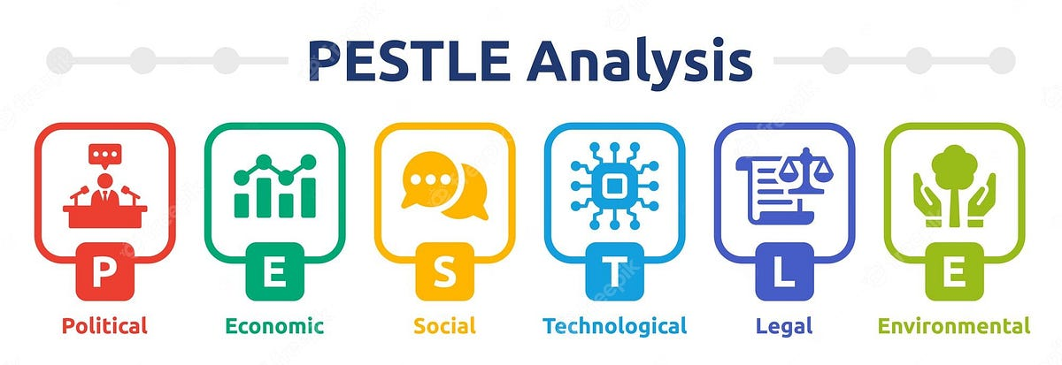
TOPIC 01
PESTLE
ITIL 4 Foundation Training · TGS-2024049350
© 2026 Tertiary Infotech Academy Pte Ltd · UEN 201200696W
75

Slide 77
QUIZ 1
Knowledge Check
Within ITIL 4, how many components make up the Service Value System?
4
5
a
b
6
7
c
d
ITIL 4 Foundation Training · TGS-2024049350
© 2026 Tertiary Infotech Academy Pte Ltd · UEN 201200696W
76

Slide 78
QUIZ 2
Knowledge Check
What are the inputs to Service Value System?
Demand or value
Value or cost
a
b
Opportunities or risk
Demand or opportunities
c
d
ITIL 4 Foundation Training · TGS-2024049350
© 2026 Tertiary Infotech Academy Pte Ltd · UEN 201200696W
77

Slide 79
QUIZ 3
Knowledge Check
Service value chain is define as:
A set of interconnected tasks that are performed to deliver value
A set of interconnected activities that are performed to deliver good to consumers
a
b
A set of interconnected procedure that are performed to deliver service
A set of interconnected activities that are performed to deliver a product or service to consumers
c
d
ITIL 4 Foundation Training · TGS-2024049350
© 2026 Tertiary Infotech Academy Pte Ltd · UEN 201200696W
78

Slide 80
QUIZ 4
Knowledge Check
Which component within ITIL SVS is supposed to make recommendations to guide an organization in all circumstances?
Organization and people
34 practices
a
b
Continual improvement
Guiding principles
c
d
ITIL 4 Foundation Training · TGS-2024049350
© 2026 Tertiary Infotech Academy Pte Ltd · UEN 201200696W
79

Slide 81
QUIZ 5
Knowledge Check
ITIL ensures a holistic approach to ITSM through the consideration of?
Service Value System
Governance
a
b
Four dimensions of service management
34 practices
c
d
ITIL 4 Foundation Training · TGS-2024049350
© 2026 Tertiary Infotech Academy Pte Ltd · UEN 201200696W
80

Slide 82
QUIZ 6
Knowledge Check
How many roles are there for consumers?
1
2
a
b
3
4
c
d
ITIL 4 Foundation Training · TGS-2024049350
© 2026 Tertiary Infotech Academy Pte Ltd · UEN 201200696W
81

Slide 83
QUIZ 7
Knowledge Check
The definition of cost from ITIL perspective
Money gain from using the service
Business lost from the using the service
a
b
Money spent on resources or specific activity
Money saved from using the service
c
d
ITIL 4 Foundation Training · TGS-2024049350
© 2026 Tertiary Infotech Academy Pte Ltd · UEN 201200696W
82

Slide 84
QUIZ 8
Knowledge Check
Utility is defined as:
Assurance that a service will meet agreed-upon requirements
Functionality of the service to meet a particular need
a
b
How it performs and whether it is fit for use
How it facilitates its desired outcome and create value
c
d
ITIL 4 Foundation Training · TGS-2024049350
© 2026 Tertiary Infotech Academy Pte Ltd · UEN 201200696W
83

Slide 85
QUIZ 9
Knowledge Check
What is a description of one or more services, designed to address the needs of a target consumer group?
Products
Resources
a
b
Goods
Service offering
c
d
ITIL 4 Foundation Training · TGS-2024049350
© 2026 Tertiary Infotech Academy Pte Ltd · UEN 201200696W
84

Slide 86
QUIZ 10
Knowledge Check
When services are delivered by the provider, they create new ___________ for service consumers or modify their existing ones.
Value
Risk
a
b
Cost
Resources
c
d
ITIL 4 Foundation Training · TGS-2024049350
© 2026 Tertiary Infotech Academy Pte Ltd · UEN 201200696W
85

Slide 87
QUIZ 11
Knowledge Check
What is the definition of warranty?
A tangible or intangible deliverable that is produced by carrying out an activity
The assurance that a product or service will meet agreed requirements
a
b
A possible event that could cause harm or loss or make it more difficult to achieve objectives
The functionality offered by a product or service to meet a particular need
c
d
ITIL 4 Foundation Training · TGS-2024049350
© 2026 Tertiary Infotech Academy Pte Ltd · UEN 201200696W
86

Slide 88
IN-CLASS ACTIVITY
Case Study
1. Tech Solutions Inc. is a global IT services company established in 2005, employing over 15,000 professionals across North America, Europe, and Asia. It has been ranked among the top 10 IT service providers by Global IT Services Magazine. The company offers a wide range of services, including IT consulting, software development, cloud solutions, cybersecurity, and managed IT services.
ITIL 4 Foundation Training · TGS-2024049350
© 2026 Tertiary Infotech Academy Pte Ltd · UEN 201200696W
87

Slide 89
IN-CLASS ACTIVITY
Case Study
1. With the increasing adoption of cloud computing and remote work solutions, Tech Solutions Inc. sees an opportunity to expand its cloud services offerings. The company plans to introduce a new range of cloud solutions designed to help businesses transition smoothly to the cloud, enhance cybersecurity, and manage their IT infrastructure more efficiently.
ITIL 4 Foundation Training · TGS-2024049350
© 2026 Tertiary Infotech Academy Pte Ltd · UEN 201200696W
88

Slide 90
IN-CLASS ACTIVITY
Case Study
1. Cloud Solutions Packages:
ITIL 4 Foundation Training · TGS-2024049350
© 2026 Tertiary Infotech Academy Pte Ltd · UEN 201200696W
89

Slide 91
IN-CLASS ACTIVITY
Case Study
1. All packages guarantee a smooth transition within 10 business days. If customers do not receive any updates within this period, they can contact the 24/7 support hotline or use the online customer portal with chatbot assistance.
2. As the company expands its services, there is a need for better insight into customer satisfaction and service performance. The IT Director has been tasked with evaluating a service management solution to address this need.
ITIL 4 Foundation Training · TGS-2024049350
© 2026 Tertiary Infotech Academy Pte Ltd · UEN 201200696W
90

Slide 92
IN-CLASS ACTIVITY
Case Study
1. Divide the class into 2-4 small groups, each with 2-3 persons.
2. Scenario Analysis from ITIL Context
3. Questions:
4. 1: List examples of opportunity and value
5. 2: Consider external factors leveraged by the company
6. 3: What are the goods, access to resources, and service actions
7. 4: What are the consideration factors for service management solution
ITIL 4 Foundation Training · TGS-2024049350
© 2026 Tertiary Infotech Academy Pte Ltd · UEN 201200696W
91

Slide 93
IN-CLASS ACTIVITY
Case Study
1. Presentation:
2. Groups will discuss their findings and present them to the rest of the class.
3. Each group should clearly justify their answers, mentioning any assumptions made during the analysis.
4. Assumptions:
5. Assumptions may include specific market conditions, customer behaviors, or technological capabilities available to the company.
ITIL 4 Foundation Training · TGS-2024049350
© 2026 Tertiary Infotech Academy Pte Ltd · UEN 201200696W
92

Slide 94
02
TOPIC 02
ITIL Guiding Principles
Focus on Value · Start Where You Are · Progress Iteratively · Collaborate · Think Holistically · Keep It Simple · Optimize and Automate
ITIL 4 Foundation Training · TGS-2024049350
© 2026 Tertiary Infotech Academy Pte Ltd · UEN 201200696W
93

Slide 95
TOPIC 02
Topics
1
Focus on Value
2
Start Where You Are
3
Progress Iteratively with Feedback
4
Collaborate and Promote Visibility
5
Think and Work Holistically
6
Keep It Simple and Practical
7
Optimize and Automate
ITIL 4 Foundation Training · TGS-2024049350
© 2026 Tertiary Infotech Academy Pte Ltd · UEN 201200696W
94

Slide 96
TOPIC 02
What Is a Guiding Principle?
1
A guiding principle is a recommendation that guides an organisation in ALL circumstances, regardless of changes in its goals, strategies, type of work or management structure.
2
The principles are universal and enduring — they do not change when the organisation's situation changes.
3
They embody the core messages of ITIL and of service management generally.
4
They support successful action and good decisions at every level, from strategy to a single ticket.
5
There are SEVEN principles, and an organisation need not adopt them one at a time — they reinforce each other.
HOW THEY ARE USED
EXAM TIP
Faced with any decision, ask which principles apply and what each would have you do — and stop doing.
Universality is the defining trait: 'in all circumstances, regardless of changes'.
ITIL 4 Foundation Training · TGS-2024049350
© 2026 Tertiary Infotech Academy Pte Ltd · UEN 201200696W
95

Slide 97
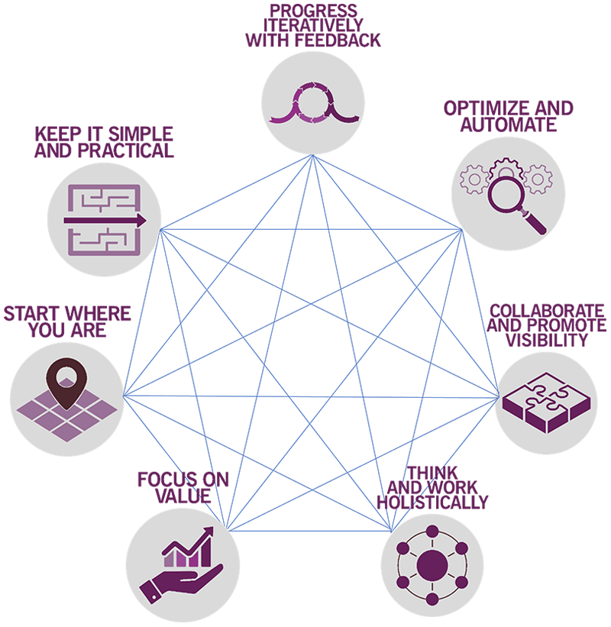
TOPIC 02
7 ITIL Guiding Principles
ITIL 4 Foundation Training · TGS-2024049350
© 2026 Tertiary Infotech Academy Pte Ltd · UEN 201200696W
96

Slide 98
TOPIC 02
7 ITIL Guiding Principles
1
Focus on value
2
Start where you are
3
Progress iteratively with feedback
4
Collaborate and promote visibility
5
Think and work holistically
6
Keep it simple and practical
7
Optimize and automate.
ITIL 4 Foundation Training · TGS-2024049350
© 2026 Tertiary Infotech Academy Pte Ltd · UEN 201200696W
97

Slide 99
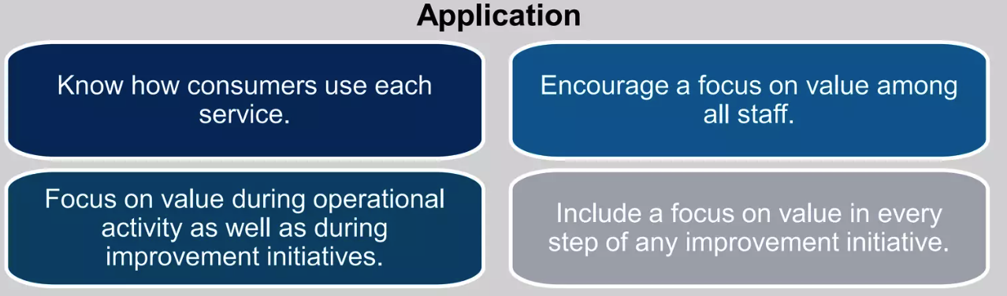
TOPIC 02
Focus on Value Principle
Everything the organization does should link back, directly or indirectly, to value for itself, its customers, and other stakeholders.
ITIL 4 Foundation Training · TGS-2024049350
© 2026 Tertiary Infotech Academy Pte Ltd · UEN 201200696W
98

Slide 100
TOPIC 02
Focus on Value
1
Everything the organisation does should link back, directly or indirectly, to value for itself, its customers and its other stakeholders.
2
Start by knowing WHO is being served — the consumer, and any other stakeholder affected.
3
Then establish WHAT is being delivered or improved for them, and what they actually consider valuable.
4
Value is defined by the CONSUMER, not by the provider's opinion of its own service.
5
Value takes many forms: revenue, customer loyalty, reduced cost, reduced risk, better experience.
APPLYING IT
EXAM TIP
Before adding a feature, ask which consumer outcome it improves. If nobody can answer, it is not value.
'Know who is being served' and 'understand what the consumer values' are the signature phrases.
ITIL 4 Foundation Training · TGS-2024049350
© 2026 Tertiary Infotech Academy Pte Ltd · UEN 201200696W
99

Slide 101
TOPIC 02
Focus on Value
1
Know who is being served
2
What is being delivered or improved for the service consumer and/or stakeholders
3
What is truly of value to the service consumer
4
Why the consumer use the service
5
What services help them
6
How the services help them achieve goals
7
Role of cost/financial consequences for service consumer
8
Risks involved for the service
ITIL 4 Foundation Training · TGS-2024049350
© 2026 Tertiary Infotech Academy Pte Ltd · UEN 201200696W
100

Slide 102
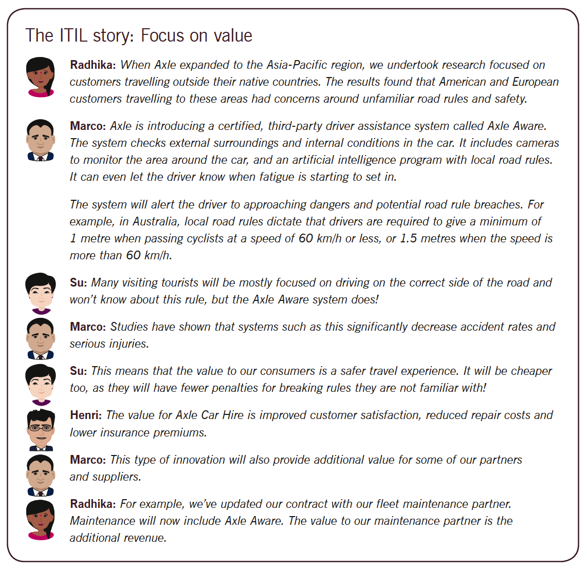
TOPIC 02
Focus on Value
ITIL 4 Foundation Training · TGS-2024049350
© 2026 Tertiary Infotech Academy Pte Ltd · UEN 201200696W
101

Slide 103

TOPIC 02
Example: IT Service Desk Implementation
• A company is planning to implement a new IT service desk to support its employees and ensure smooth IT operations.
• Application of the Focus on Value Principle:
• Identify Stakeholders and Their Needs:
• Define Value from the Stakeholders' Perspective:
• Design Services to Deliver Value:
• Measure and Communicate Value:
• Continuous Improvement:
ITIL 4 Foundation Training · TGS-2024049350
© 2026 Tertiary Infotech Academy Pte Ltd · UEN 201200696W
102

Slide 104
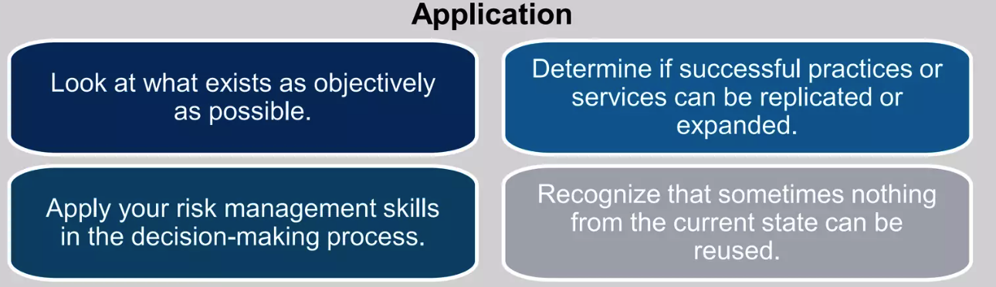
TOPIC 02
Start Where You Are’ Principle
Do not start over without first considering what is already available to be leveraged."
ITIL 4 Foundation Training · TGS-2024049350
© 2026 Tertiary Infotech Academy Pte Ltd · UEN 201200696W
103

Slide 105
TOPIC 02
Start Where You Are Principle
1
Avoid discarding old methods/services entirely
2
Building new from scratch often wasteful
3
Evaluate and leverage existing resources
4
Preserve valuable services, processes, people, and tools
5
Services and methods already in place should be measured and/or observed directly to properly understand their current state and what can be reused from them.
6
Those observing an activity should not be afraid to ask what may seem to be stupid questions.
7
The use of measurement is important to this principle.
8
Organizations should consider a variety of techniques to develop knowledge of the environments in which they work
ITIL 4 Foundation Training · TGS-2024049350
© 2026 Tertiary Infotech Academy Pte Ltd · UEN 201200696W
104

Slide 106
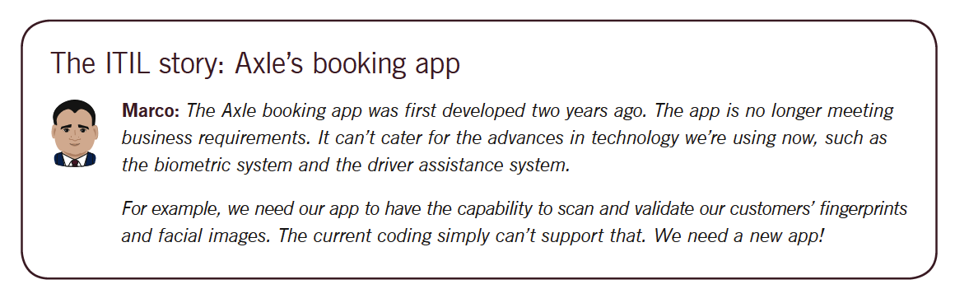
TOPIC 02
Start Where You Are
ITIL 4 Foundation Training · TGS-2024049350
© 2026 Tertiary Infotech Academy Pte Ltd · UEN 201200696W
105

Slide 107
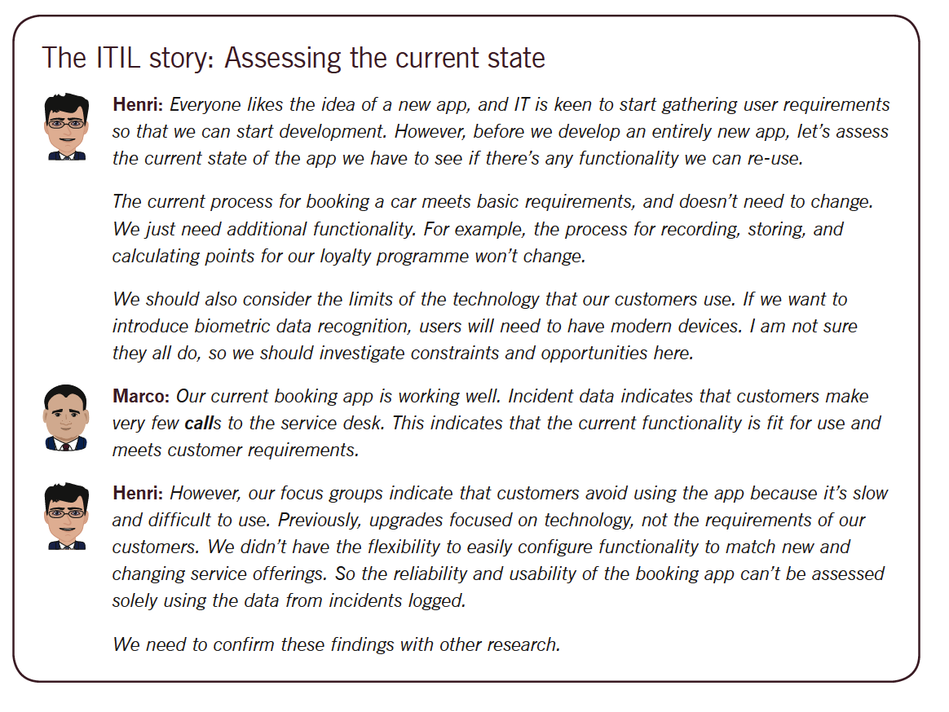
TOPIC 02
Start Where You Are
ITIL 4 Foundation Training · TGS-2024049350
© 2026 Tertiary Infotech Academy Pte Ltd · UEN 201200696W
106

Slide 108

TOPIC 02
Example: Improving Incident Management in an IT Department
• An IT department in a medium-sized company is experiencing frequent downtime and delays in resolving incidents. The new IT manager wants to improve the incident management process but recognizes that completely overhauling the system might be disruptive.
• Application of the Start Where You Are’ Principle:
• Assess Current State
• Identify Existing Strengths
• Leverage What Works
• Implement Incremental Improvements
• Monitor and Adjust
• Continuous Improvement
ITIL 4 Foundation Training · TGS-2024049350
© 2026 Tertiary Infotech Academy Pte Ltd · UEN 201200696W
107

Slide 109
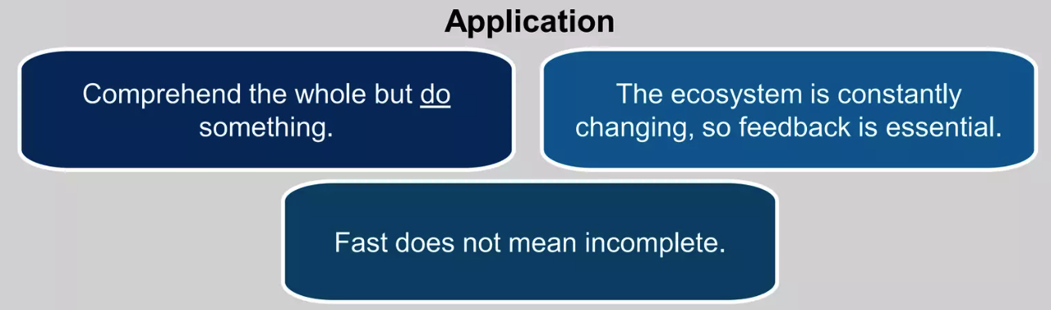
TOPIC 02
Progress Iteratively with Feedback
Resist the temptation to do everything at once. Even huge initiatives must be accomplished iteratively. By organizing work into smaller, manageable sections that can be executed and completed in a timely manner, the focus on each effort will be sharper and easier to maintain.
ITIL 4 Foundation Training · TGS-2024049350
© 2026 Tertiary Infotech Academy Pte Ltd · UEN 201200696W
108

Slide 110
TOPIC 02
Progress Iteratively with Feedback
1
Resist the temptation to do everything at once — even huge initiatives must be accomplished iteratively.
2
Organise work into smaller, manageable sections that can be executed and completed in a timely manner.
3
Each iteration should deliver something of value, not merely progress towards a distant end state.
4
Seek and use FEEDBACK before, throughout and after each iteration — feedback is what makes iteration work.
5
Iteration reduces risk: problems surface early, while they are still cheap to correct.
APPLYING IT
EXAM TIP
Pilot a new service desk tool with one team for two weeks, act on what they report, then extend it.
Iteration WITHOUT feedback is just phasing. The feedback loop is the point of the principle.
ITIL 4 Foundation Training · TGS-2024049350
© 2026 Tertiary Infotech Academy Pte Ltd · UEN 201200696W
109

Slide 111
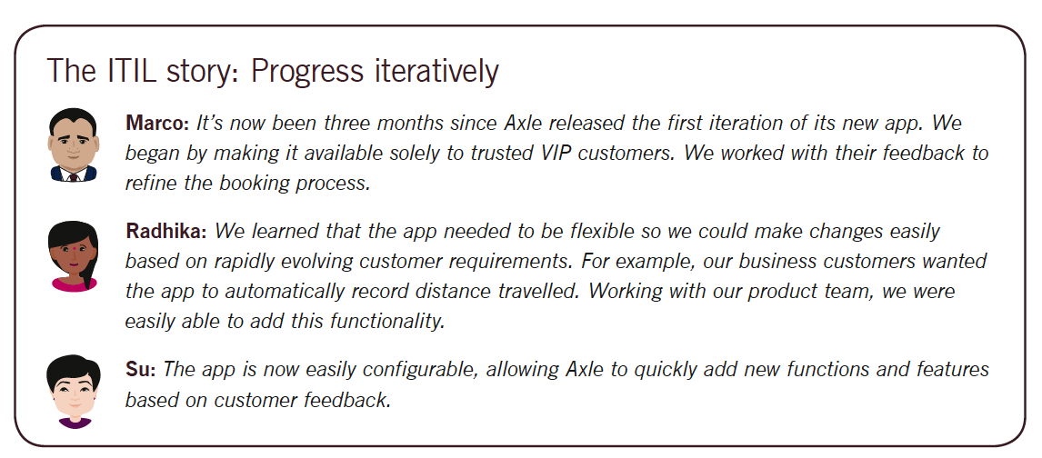
TOPIC 02
Progress Iteratively with Feedback
ITIL 4 Foundation Training · TGS-2024049350
© 2026 Tertiary Infotech Academy Pte Ltd · UEN 201200696W
110

Slide 112
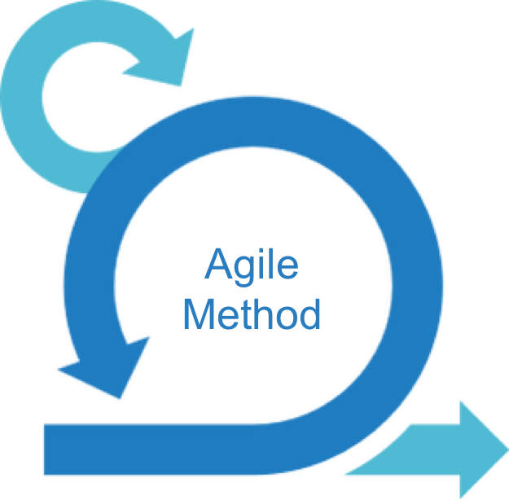
TOPIC 02
Example: Agile
• Agile methodology is fundamentally aligned with the "Progress Iteratively with Feedback" principle, as both emphasize incremental development, continuous improvement, and responsiveness to change. Here’s how Agile aligns with this principle:
• Incremental Development
• Frequent Feedback Loops
• Continuous Integration and Testing
• Customer Involvement
• Adaptive Planning
• Empowered Teams
• Small, Usable Deliverables
ITIL 4 Foundation Training · TGS-2024049350
© 2026 Tertiary Infotech Academy Pte Ltd · UEN 201200696W
111

Slide 113

TOPIC 02
Example: Implementing a New CRM System
• A sales department in a growing company decides to implement a new CRM system to better manage customer interactions, track sales activities, and improve overall efficiency.
• Application of the Progress Iteratively with Feedback Principle:
• Initial Assessment and Planning
• Phase 1: Basic CRM Implementation:
• Gather Feedback
• Phase 2: Customization and Enhancement
• Continuous Feedback and Iteration
• Phase 3: Full Deployment and Ongoing Improvement
ITIL 4 Foundation Training · TGS-2024049350
© 2026 Tertiary Infotech Academy Pte Ltd · UEN 201200696W
112

Slide 114
TOPIC 02
Collaborate and Promote Visibility
1
When initiatives involve the right people in the correct roles, efforts benefit from better buy-in and more relevance.
2
Collaboration across boundaries produces a greater likelihood of long-term success than isolated silo activity.
3
Identify and involve ALL relevant stakeholders, not only the obvious or the convenient ones.
4
Promote visibility: work that is hidden cannot be prioritised, supported or improved.
5
Poor visibility leads to poor decisions — people assume rather than know what is happening.
APPLYING IT
EXAM TIP
A visible Kanban board of live work stops leaders from adding urgent requests onto an already-saturated team.
Two halves: involve the RIGHT PEOPLE, and make the work VISIBLE. Expect both in the answer.
ITIL 4 Foundation Training · TGS-2024049350
© 2026 Tertiary Infotech Academy Pte Ltd · UEN 201200696W
113

Slide 115
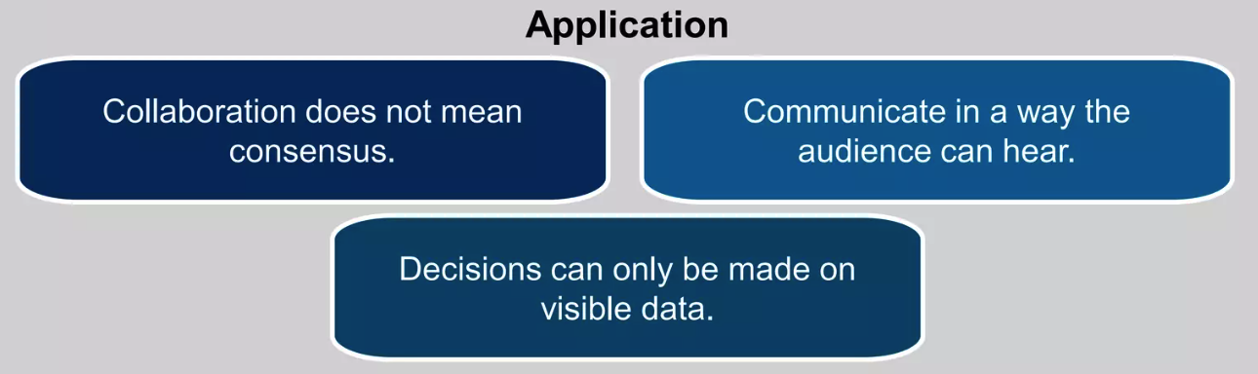
TOPIC 02
Collaborate and Promote Visibility
Cooperation and collaboration over isolated 'silo activity. Think and work holistically to break down work silos. Effective collaboration is essential for Agile, Lean, ITSM frameworks. Real accomplishment needs information, understanding, and trust
ITIL 4 Foundation Training · TGS-2024049350
© 2026 Tertiary Infotech Academy Pte Ltd · UEN 201200696W
114

Slide 116
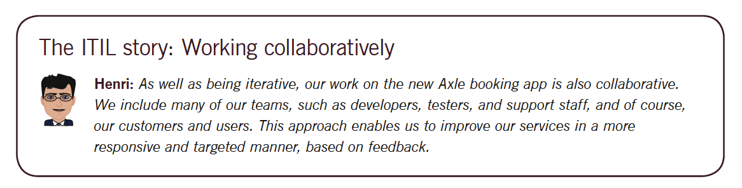
TOPIC 02
Collaborate and Promote Visibility’
ITIL 4 Foundation Training · TGS-2024049350
© 2026 Tertiary Infotech Academy Pte Ltd · UEN 201200696W
115

Slide 117
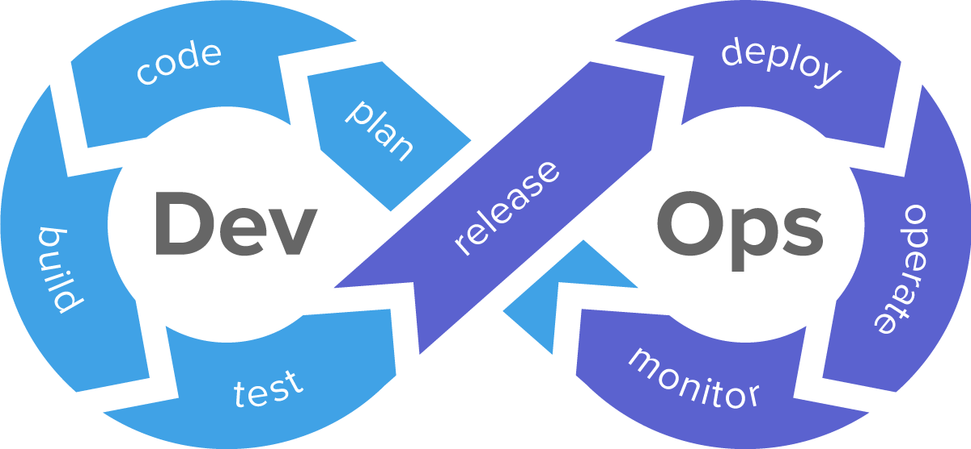
TOPIC 02
Example: DevOps
• DevOps aligns closely with the "Collaborate and Promote Visibility" principle by fostering an environment where development and operations teams work together seamlessly and transparently. Here’s how:
• Cross-Functional Teams
• Shared Responsibility
• Continuous Communication
• Transparent Processes
• Feedback Loops
• Collaborative Problem-Solving
ITIL 4 Foundation Training · TGS-2024049350
© 2026 Tertiary Infotech Academy Pte Ltd · UEN 201200696W
116

Slide 118

TOPIC 02
Example: Developing a New Product Feature
• A software company decides to develop a new feature for its flagship product. This project requires collaboration across multiple departments, including product management, development, quality assurance (QA), marketing, and customer support.
• Application of the Collaborate and Promote Visibility Principle:
• Initial Planning and Collaboration
• Regular Communication and Updates
• Promote Visibility of Work
• Gathering Feedback and Making Adjustment
• Final Preparations and Launch
ITIL 4 Foundation Training · TGS-2024049350
© 2026 Tertiary Infotech Academy Pte Ltd · UEN 201200696W
117

Slide 119
TOPIC 02
Think and Work Holistically
1
No service, practice, process, department or supplier stands alone.
2
The outputs an organisation delivers to itself, its customers and other stakeholders will suffer unless it works on the whole, not just on the parts.
3
Establish an understanding of how all parts of the organisation work together in an integrated way.
4
Work towards END-TO-END delivery: optimising one step at the expense of the whole makes the service worse.
5
Apply all FOUR DIMENSIONS when planning any change — people, information and technology, partners, and value streams.
APPLYING IT
EXAM TIP
A faster deployment pipeline is no gain if the service desk is not trained to support what it now ships weekly.
Signature phrase: 'approach activities as related to the whole rather than as separate parts'.
ITIL 4 Foundation Training · TGS-2024049350
© 2026 Tertiary Infotech Academy Pte Ltd · UEN 201200696W
118

Slide 120
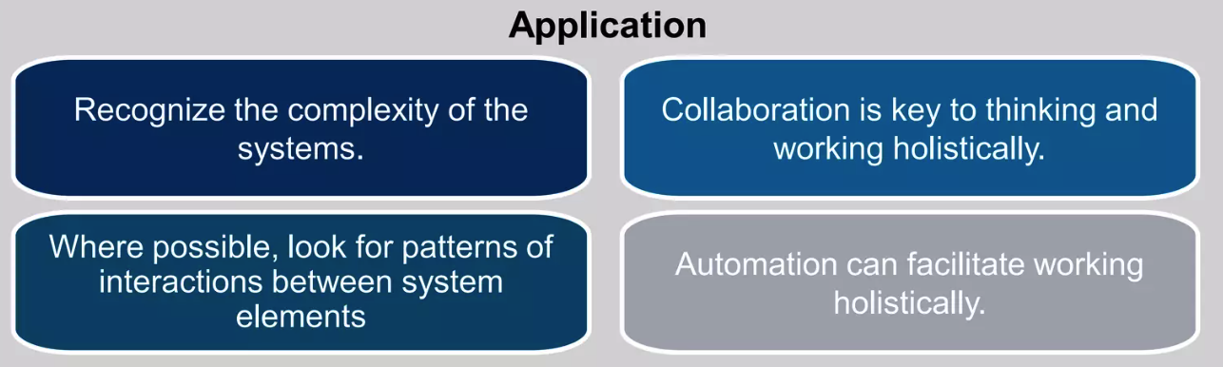
TOPIC 02
‘Think and Work Holistically’ Principle
Establish an understanding of how all parts of an organization work together in an integrated way
ITIL 4 Foundation Training · TGS-2024049350
© 2026 Tertiary Infotech Academy Pte Ltd · UEN 201200696W
119

Slide 121
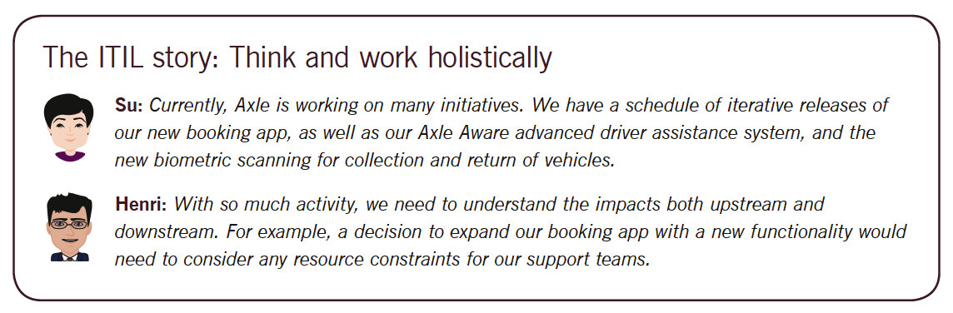
TOPIC 02
Think and Work Holistically
ITIL 4 Foundation Training · TGS-2024049350
© 2026 Tertiary Infotech Academy Pte Ltd · UEN 201200696W
120

Slide 122

TOPIC 02
Example: Implementing a New ERP System
• A IT company decides to implement a new ERP system to integrate and streamline its operations, which include procurement, production, sales, inventory management, and finance.
• Application of the Think and Work Holistically Principle:
• Comprehensive Needs Assessment
• Integrated Planning
• Cross-Functional Team Collaboration
• Holistic System Design
• Comprehensive Training and Change Management
• Ongoing Monitoring and Improvement
ITIL 4 Foundation Training · TGS-2024049350
© 2026 Tertiary Infotech Academy Pte Ltd · UEN 201200696W
121

Slide 123
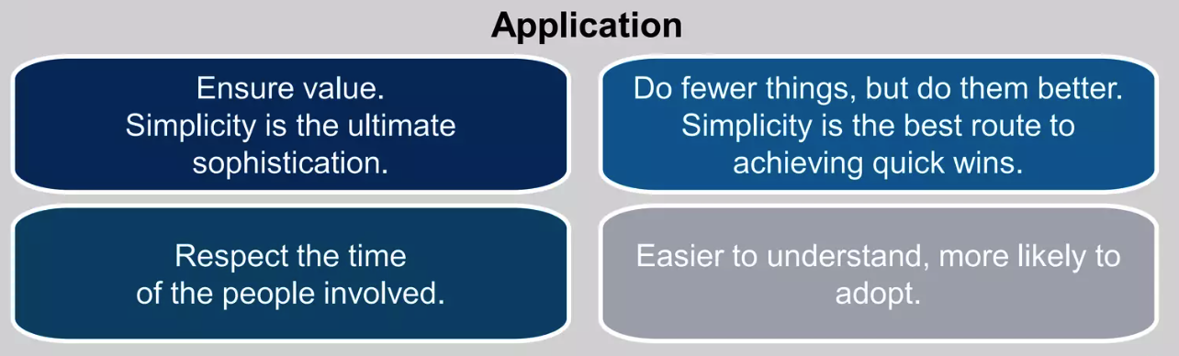
TOPIC 02
Keep It Simple and Practical
Always use the minimum number of steps to accomplish an objective. Outcome-based thinking should be used to produce practical solutions that deliver valuable outcomes. If a process, service, action, or metric fails to provide value or produce a useful outcome, then eliminate it.
ITIL 4 Foundation Training · TGS-2024049350
© 2026 Tertiary Infotech Academy Pte Ltd · UEN 201200696W
122

Slide 124
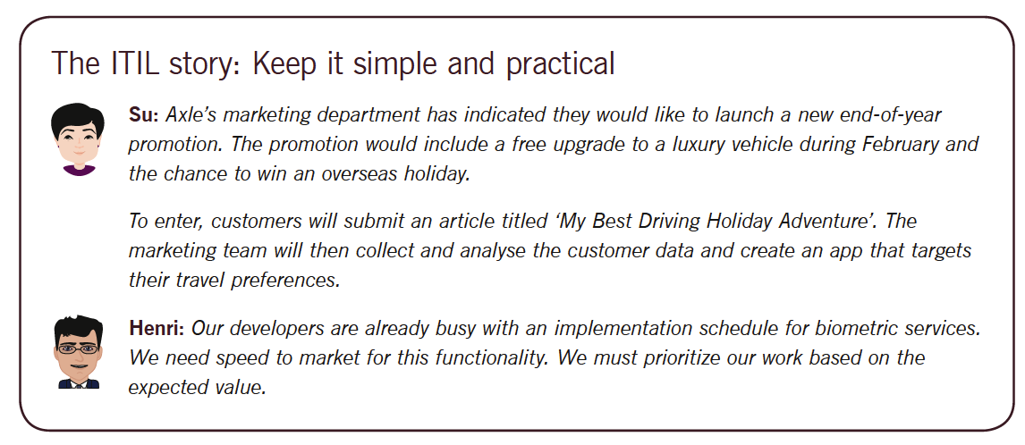
TOPIC 02
Keep It Simple and Practical
ITIL 4 Foundation Training · TGS-2024049350
© 2026 Tertiary Infotech Academy Pte Ltd · UEN 201200696W
123

Slide 125

TOPIC 02
Example: Streamlining the Onboarding Process for New Employees
• A medium-sized IT company wants to improve its onboarding process for new employees to make it more efficient and user-friendly.
• Application of the Keep It Simple and Practical Principle:
• Current Process Assessment
• Identify Key Requirements
• Simplify Documentation
• Automate Where Possible
• Practical Training Sessions
• Feedback and Continuous Improvement
ITIL 4 Foundation Training · TGS-2024049350
© 2026 Tertiary Infotech Academy Pte Ltd · UEN 201200696W
124

Slide 126
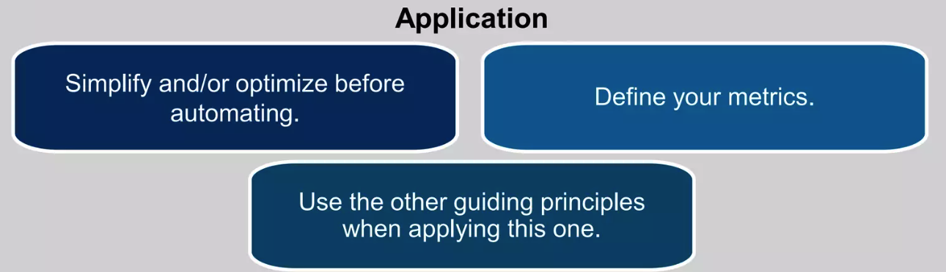
TOPIC 02
Optimize and Automate Principle
Organizations must maximize the value of the work carried out by their human and technical resources. Technology can help organizations to scale up and take on frequent and repetitive tasks, allowing human resources to be used for more complex decision-making.
ITIL 4 Foundation Training · TGS-2024049350
© 2026 Tertiary Infotech Academy Pte Ltd · UEN 201200696W
125

Slide 127
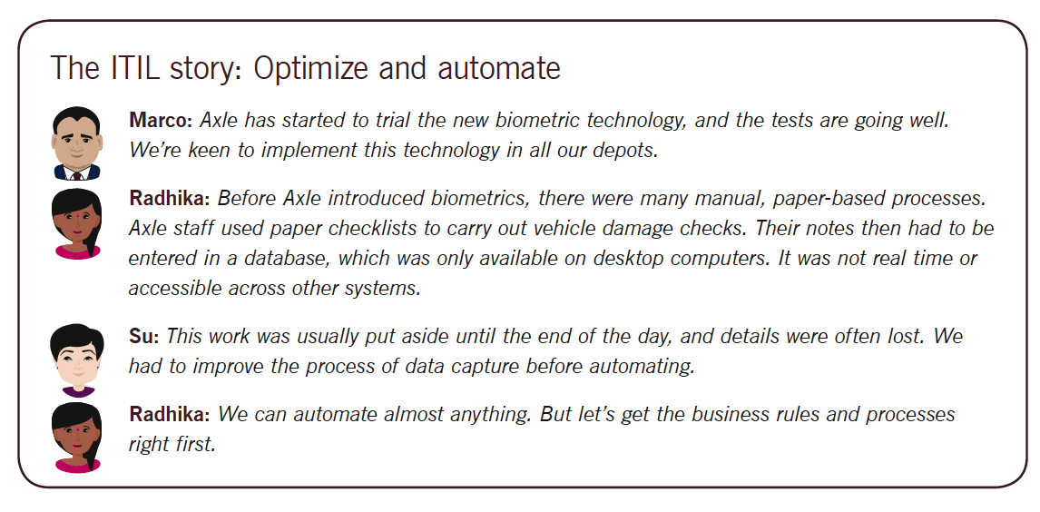
TOPIC 02
Optimize and Automate
ITIL 4 Foundation Training · TGS-2024049350
© 2026 Tertiary Infotech Academy Pte Ltd · UEN 201200696W
126

Slide 128

TOPIC 02
Example: Optimizing and Automating IT Incident Management
• A large IT department in a financial services company is struggling with managing IT incidents due to a high volume of manual tasks, leading to slow resolution times and frequent errors.
• Application of the Optimize and Automate Principle:
• Initial Assessment and Optimization
• Implement Standard Operating Procedures (SOPs)
• Select Appropriate Automation Tools
• Automation Implementation
• Monitoring and Continuous Improvement
• Scaling Automation:
ITIL 4 Foundation Training · TGS-2024049350
© 2026 Tertiary Infotech Academy Pte Ltd · UEN 201200696W
127

Slide 129
TOPIC 02
Example: RPA
1
Robotic Process Automation (RPA) aligns perfectly with the "Optimize and Automate" principle by focusing on improving efficiency through process optimization and automation of repetitive tasks.
2
Identifying and Optimizing Processes
3
Automation of Repetitive Tasks
4
Integration with Existing Systems
5
Scalability
6
Continuous Monitoring and Improvement
7
Reduced Costs and Increased Efficiency
ITIL 4 Foundation Training · TGS-2024049350
© 2026 Tertiary Infotech Academy Pte Ltd · UEN 201200696W
128

Slide 130

TOPIC 02
Example: RPA in Invoice Processing
A finance department in a large organization struggles with the manual processing of hundreds of invoices daily, leading to delays and errors.
ITIL 4 Foundation Training · TGS-2024049350
© 2026 Tertiary Infotech Academy Pte Ltd · UEN 201200696W
129

Slide 131
QUIZ 12
Knowledge Check
Which principle focusing on work in an integrated way to approach activities as related to the whole, rather than as separate parts?
Focus on Value
Keep it simple and practical
a
b
Optimize and automate
Think and work holistically
c
d
ITIL 4 Foundation Training · TGS-2024049350
© 2026 Tertiary Infotech Academy Pte Ltd · UEN 201200696W
130

Slide 132
QUIZ 13
Knowledge Check
Which principle put the right people in the correct roles to ensure that initiatives have an increased likelihood of long-term success?
Focus on Value
Progress iteratively with feedback
a
b
Collaborate and promote visibility
Keep it simple and practical
c
d
ITIL 4 Foundation Training · TGS-2024049350
© 2026 Tertiary Infotech Academy Pte Ltd · UEN 201200696W
131

Slide 133
QUIZ 14
Knowledge Check
Which is a recommended principle when applying ‘Focus on Value’ and “Progress iteratively with feedback’ principles?
Optimize and automate
Think and work holistically
a
b
Collaborate and promote visibility
Start where you are
c
d
ITIL 4 Foundation Training · TGS-2024049350
© 2026 Tertiary Infotech Academy Pte Ltd · UEN 201200696W
132

Slide 134
QUIZ 15
Knowledge Check
Which principle understands the flow of work in progress, identify bottlenecks and excess capacity and uncover waste?
Keep it simple and practical
Optimize and automate
a
b
Progress iteratively with feedback
Collaborate and promote visibility
c
d
ITIL 4 Foundation Training · TGS-2024049350
© 2026 Tertiary Infotech Academy Pte Ltd · UEN 201200696W
133

Slide 135
QUIZ 16
Knowledge Check
What describe the ‘Focus on Value’ principle? services
Involve the right people in the right roles
Establish an understanding of what is truly value to the service consumer
a
b
Identify what existing resources can be utilized to deliver the services
Establish how all the parts of the organization will work together to deliver the
c
d
ITIL 4 Foundation Training · TGS-2024049350
© 2026 Tertiary Infotech Academy Pte Ltd · UEN 201200696W
134

Slide 136
03
TOPIC 03
The Four Dimensions of Service Management
Organizations and People · Information and Technology · Partners and Suppliers · Value Streams and Processes
ITIL 4 Foundation Training · TGS-2024049350
© 2026 Tertiary Infotech Academy Pte Ltd · UEN 201200696W
135

Slide 137
TOPIC 03
Topics
• Organizations and People
• Information and Technology
• Partners and Suppliers
• Value Streams and Processes
ITIL 4 Foundation Training · TGS-2024049350
© 2026 Tertiary Infotech Academy Pte Ltd · UEN 201200696W
136

Slide 138
TOPIC 03
Four Dimension
ITIL 4 Foundation Training · TGS-2024049350
© 2026 Tertiary Infotech Academy Pte Ltd · UEN 201200696W
137

Slide 139
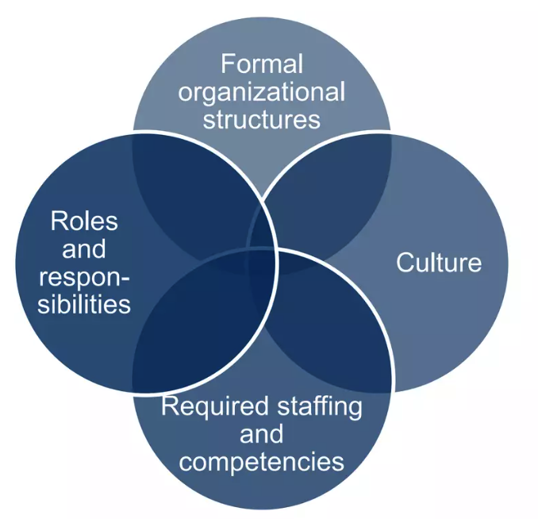
TOPIC 03
Organization and People Dimension
The organization and people dimension of a service covers roles and responsibilities, leaders championing and advocating the values, communication and collaboration, shared values and attitudes, trust and transparency, and the right level of capacity and competency in the workforce, all of which are related to the creation, delivery, and improvement of a service.
ITIL 4 Foundation Training · TGS-2024049350
© 2026 Tertiary Infotech Academy Pte Ltd · UEN 201200696W
138

Slide 140
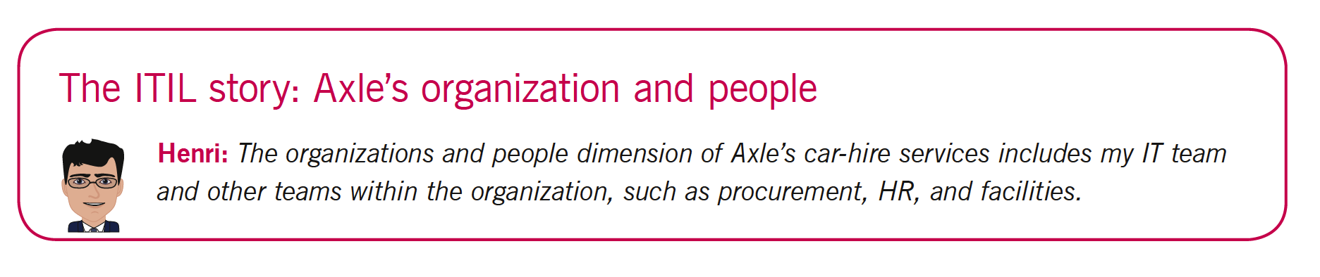
TOPIC 03
Organization and People Dimension
ITIL 4 Foundation Training · TGS-2024049350
© 2026 Tertiary Infotech Academy Pte Ltd · UEN 201200696W
139

Slide 141

TOPIC 03
Information and Technology Dimension
When applied to the SVS, the information and technology dimension includes the information and knowledge necessary for the management of services, as well as the technologies required.
ITIL 4 Foundation Training · TGS-2024049350
© 2026 Tertiary Infotech Academy Pte Ltd · UEN 201200696W
140

Slide 142
TOPIC 03
Supporting and enabling Technologies
1
Workflow management systems
2
Knowledge bases
3
Inventory systems
4
Communication systems
5
Analytical tools
ITIL 4 Foundation Training · TGS-2024049350
© 2026 Tertiary Infotech Academy Pte Ltd · UEN 201200696W
141

Slide 143
TOPIC 03
Information Technology Considerations
1
Is it compatible with current architecture and customers?
2
Does it raise compliance issues with policies and information security
3
controls?
4
Will it continue to be viable in the future
5
Does it align with service provider or consumer strategies?
6
Does the organization have the right skills to support and maintain it?
7
Does it have sufficient automation capabilities?
8
Does it have additional capabilities that can be leveraged?
ITIL 4 Foundation Training · TGS-2024049350
© 2026 Tertiary Infotech Academy Pte Ltd · UEN 201200696W
142

Slide 144

TOPIC 03
Information and Technology Dimension
ITIL 4 Foundation Training · TGS-2024049350
© 2026 Tertiary Infotech Academy Pte Ltd · UEN 201200696W
143

Slide 145

TOPIC 03
Partners and Suppliers Dimension
The partners and suppliers dimension encompasses an organization’s relations with other organizations that are involved in the design, development, deployment, delivery, support, and/or continual improvement of services.
ITIL 4 Foundation Training · TGS-2024049350
© 2026 Tertiary Infotech Academy Pte Ltd · UEN 201200696W
144

Slide 146
TOPIC 03
Supplier Strategy Considerations
1
Strategic focus
2
Resource scarcity
3
Corporate culture
4
Demand patterns
5
Cost concerns
6
Subject matter expertise
7
External constraints
ITIL 4 Foundation Training · TGS-2024049350
© 2026 Tertiary Infotech Academy Pte Ltd · UEN 201200696W
145

Slide 147

TOPIC 03
Partners and Suppliers Dimension
ITIL 4 Foundation Training · TGS-2024049350
© 2026 Tertiary Infotech Academy Pte Ltd · UEN 201200696W
146

Slide 148

TOPIC 03
Partners and Suppliers Dimension
ITIL 4 Foundation Training · TGS-2024049350
© 2026 Tertiary Infotech Academy Pte Ltd · UEN 201200696W
147

Slide 149

TOPIC 03
Value Stream and Processes
Applied to the organization and its SVS, the value streams and processes dimension is concerned with how the various parts of the organization work in an integrated and coordinated way to enable value creation through products and services.
ITIL 4 Foundation Training · TGS-2024049350
© 2026 Tertiary Infotech Academy Pte Ltd · UEN 201200696W
148

Slide 150
TOPIC 03
Value Streams
1
A VALUE STREAM is a series of steps an organisation undertakes to create and deliver products and services to consumers.
2
It is a specific combination of service value chain activities, arranged for a particular scenario.
3
Value streams are designed around the consumer's journey, not around the organisation's departments.
4
Mapping a value stream exposes bottlenecks, waste, rework and hand-off delays that no single team can see.
5
Improving the value stream is how an organisation improves the end-to-end experience rather than a local step.
A NEW-STARTER VALUE STREAM
EXAM TIP
Request → approve → provision accounts → issue laptop → grant access → confirm ready — crossing HR, IT and facilities.
Value STREAM = the end-to-end path for one scenario. Value CHAIN = the six generic activities it draws on.
ITIL 4 Foundation Training · TGS-2024049350
© 2026 Tertiary Infotech Academy Pte Ltd · UEN 201200696W
149

Slide 151

TOPIC 03
Service Value Streams
ITIL 4 Foundation Training · TGS-2024049350
© 2026 Tertiary Infotech Academy Pte Ltd · UEN 201200696W
150

Slide 152
TOPIC 03
Processes
1
A PROCESS is a set of interrelated or interacting activities that transforms inputs into outputs.
2
A process defines the sequence of actions and their dependencies — what is done, in what order, to achieve an objective.
3
Processes describe WHAT is done; procedures describe HOW; work instructions describe the detailed steps for a specific role.
4
Well-defined processes improve productivity within and across organisations, and make outcomes repeatable.
5
Processes should be designed to produce a specific outcome for a specific stakeholder — never for their own sake.
HIERARCHY IN PRACTICE
EXAM TIP
Process: handle an incident. Procedure: how the service desk triages it. Work instruction: the exact steps to reset an AD password.
Work instruction = HOW something is carried out, in detail, for one role. This exact distinction is examined.
ITIL 4 Foundation Training · TGS-2024049350
© 2026 Tertiary Infotech Academy Pte Ltd · UEN 201200696W
151

Slide 153

TOPIC 03
Process
Process is a set of interrelated or interacting activities that transforms inputs to outputs. Processes define the sequence of of activities and their dependencies
ITIL 4 Foundation Training · TGS-2024049350
© 2026 Tertiary Infotech Academy Pte Ltd · UEN 201200696W
152

Slide 154

TOPIC 03
Processes
ITIL 4 Foundation Training · TGS-2024049350
© 2026 Tertiary Infotech Academy Pte Ltd · UEN 201200696W
153

Slide 155

TOPIC 03
Value Streams and Processes
ITIL 4 Foundation Training · TGS-2024049350
© 2026 Tertiary Infotech Academy Pte Ltd · UEN 201200696W
154

Slide 156
TOPIC 03
Value Streams and Processes — Considerations
1
The same structure applies at every level: VALUE STREAMS, then PROCESSES, then PROCEDURES, then WORK INSTRUCTIONS.
2
Ask what the value streams are for each service, and how they are currently performing.
3
Ask which activities are performed, in what order, and who is accountable for each.
4
Identify bottlenecks, unnecessary hand-offs, rework and waste — they hide in the gaps between teams.
5
Optimise the flow of work end-to-end, not the efficiency of any single step in isolation.
WHERE WASTE HIDES
EXAM TIP
A request approved in 5 minutes but waiting 3 days between two teams: the delay is entirely in the hand-off.
Structure order: value stream → process → procedure → work instruction. Learn it in that direction.
ITIL 4 Foundation Training · TGS-2024049350
© 2026 Tertiary Infotech Academy Pte Ltd · UEN 201200696W
155

Slide 157
QUIZ 17
Knowledge Check
Which dimension addresses the activities organization undertake, and how they are organized to efficiently and effectively enable value co-creation for stakeholders?
Organization and people
Information and technology
a
b
Suppliers and partners
Value Stream and processes
c
d
ITIL 4 Foundation Training · TGS-2024049350
© 2026 Tertiary Infotech Academy Pte Ltd · UEN 201200696W
156

Slide 158
QUIZ 18
Knowledge Check
Which dimension will be more concern in relation to nature of the business of the company?
Organization and people
Information and technology
a
b
Suppliers and partner
Value Stream and processes
c
d
ITIL 4 Foundation Training · TGS-2024049350
© 2026 Tertiary Infotech Academy Pte Ltd · UEN 201200696W
157

Slide 159
QUIZ 19
Knowledge Check
If a company have a comprehensive plan to manage its existing organization complexity structure for growth, which dimension is this belong to?
Organization and people
Information and technology
a
b
Suppliers and partner
Value stream and processes
c
d
ITIL 4 Foundation Training · TGS-2024049350
© 2026 Tertiary Infotech Academy Pte Ltd · UEN 201200696W
158

Slide 160
QUIZ 20
Knowledge Check
Value stream is defined as: services
A series of procedures that organization uses to create and deliver products and
A series of activities flow that show organization contribute to growth
a
b
A series of step that organization uses to create and deliver products and services
Service offering from the resources through product creation
c
d
ITIL 4 Foundation Training · TGS-2024049350
© 2026 Tertiary Infotech Academy Pte Ltd · UEN 201200696W
159

Slide 161
QUIZ 21
Knowledge Check
What is work instruction?
What is carried out
When is carried out
a
b
Who is carried out
How is carried out
c
d
ITIL 4 Foundation Training · TGS-2024049350
© 2026 Tertiary Infotech Academy Pte Ltd · UEN 201200696W
160

Slide 162
04
TOPIC 04
The Service Value System
ITIL SVS · Plan · Improve · Engage · Design and Transition · Obtain/Build · Deliver and Support
ITIL 4 Foundation Training · TGS-2024049350
© 2026 Tertiary Infotech Academy Pte Ltd · UEN 201200696W
161

Slide 163
TOPIC 04
Topics
1
ITIL service value system
2
Plan
3
Improve
4
Engage
5
Design & transition
6
Obtain/build
7
Deliver & support
ITIL 4 Foundation Training · TGS-2024049350
© 2026 Tertiary Infotech Academy Pte Ltd · UEN 201200696W
162

Slide 164

TOPIC 04
The ITIL Service Value System at a Glance
ITIL 4 Foundation Training · TGS-2024049350
© 2026 Tertiary Infotech Academy Pte Ltd · UEN 201200696W
163

Slide 165

TOPIC 04
ITIL Service Value Chain
ITIL 4 Foundation Training · TGS-2024049350
© 2026 Tertiary Infotech Academy Pte Ltd · UEN 201200696W
164

Slide 166

TOPIC 04
Service Value Chain Activities
ITIL 4 Foundation Training · TGS-2024049350
© 2026 Tertiary Infotech Academy Pte Ltd · UEN 201200696W
165

Slide 167

TOPIC 04
Value Stream of Activities
Service value chain activities represent the steps an organization takes in the creation of value. Each activity contributes to the value chain by transforming specific inputs into outputs. To convert inputs into outputs, the value chain activities use different combinations of ITIL practices. Each activity may draw upon internal or third-party resources, processes, skills, and competencies from one or more practices.
ITIL 4 Foundation Training · TGS-2024049350
© 2026 Tertiary Infotech Academy Pte Ltd · UEN 201200696W
166

Slide 168
TOPIC 04
The Six Service Value Chain Activities
1
PLAN — ensures a shared understanding of the vision, current status and improvement direction for all four dimensions.
2
IMPROVE — ensures continual improvement of products, services and practices across all value chain activities.
3
ENGAGE — provides a good understanding of stakeholder needs, transparency, and continual engagement and good relationships.
4
DESIGN AND TRANSITION — ensures products and services continually meet stakeholder expectations for quality, cost and time to market.
5
OBTAIN/BUILD — ensures service components are available when and where needed, and that they meet agreed specifications.
6
DELIVER AND SUPPORT — ensures services are delivered and supported according to agreed specifications and expectations.
THEY INTERCONNECT
EXAM TIP
'Engage' captures a requirement, 'design and transition' shapes it, 'obtain/build' assembles it, 'deliver and support' runs it.
Learn the one-sentence PURPOSE of each activity — they are examined by their opening phrase.
ITIL 4 Foundation Training · TGS-2024049350
© 2026 Tertiary Infotech Academy Pte Ltd · UEN 201200696W
167

Slide 169
TOPIC 04
Plan — Value Chain Activity
1
PURPOSE: to ensure a shared understanding of the vision, current status and improvement direction for all four dimensions and all products and services across the organisation.
2
Plan sets direction; it does not do the work — it makes sure everyone is heading the same way.
3
Key inputs: policies, requirements and constraints from governance; consolidated demand and opportunity; improvement initiatives.
4
Key outputs: strategic, tactical and operational plans; portfolio decisions; architectures and policies.
5
Applies at every level — enterprise strategy down to the plan for a single service.
TYPICAL TRIGGER
EXAM TIP
Annual service portfolio review deciding which services to invest in, sustain or retire.
If a question mentions 'vision, current status and improvement direction', the answer is PLAN.
ITIL 4 Foundation Training · TGS-2024049350
© 2026 Tertiary Infotech Academy Pte Ltd · UEN 201200696W
168

Slide 170
TOPIC 04
Improve — Value Chain Activity
1
PURPOSE: to ensure continual improvement of products, services and practices across all value chain activities and all four dimensions.
2
Improve is a value chain ACTIVITY; continual improvement is also an SVS component and a PRACTICE — the same idea at three levels.
3
Improvement work is driven by measurement: you cannot improve what you do not measure.
4
Key inputs: performance information, stakeholder feedback, improvement opportunities from every other activity.
5
Key outputs: improvement initiatives and plans, updated performance information, value chain performance reports.
TYPICAL TRIGGER
EXAM TIP
Repeat incidents on one service prompt a problem review and a permanent fix rather than another restart.
Improve appears in the value chain AND as a practice AND as an SVS component — all three are examinable.
ITIL 4 Foundation Training · TGS-2024049350
© 2026 Tertiary Infotech Academy Pte Ltd · UEN 201200696W
169

Slide 171
TOPIC 04
PDCA Cycle (Deming Cycle)
1
PDCA (Plan-Do-Check-Act) is a cyclic process used for continuous improvement of processes and products. It is also known as the Deming Cycle or Shewhart Cycle. The cycle consists of four steps:
2
Plan: Identify an opportunity for improvement and plan for change. This involves setting objectives and processes necessary to deliver results in accordance with the expected output.
3
Do: Implement the plan on a small scale first to test its effectiveness. This is the phase where the plan is put into action, and data is collected for analysis.
4
Check: Study the results of the implementation and compare them against the expected outcomes. This step involves analyzing the data and identifying any differences between the actual and planned outcomes.
5
Act: Based on the results of the Check step, take action to standardize the successful improvements or make necessary adjustments if the results were not as expected. This may involve refining the plan and repeating the cycle.
ITIL 4 Foundation Training · TGS-2024049350
© 2026 Tertiary Infotech Academy Pte Ltd · UEN 201200696W
170

Slide 172
TOPIC 04
The PDCA / Deming Cycle
1
PDCA — Plan, Do, Check, Act — is a cyclic method for the continual improvement of processes and products.
2
PLAN: identify the problem and objective, and design the change to be tested.
3
DO: implement the change, ideally on a small scale first.
4
CHECK: measure the result against the objective set in the Plan step, using evidence.
5
ACT: if it worked, standardise and roll it out; if not, adjust and run the cycle again.
6
It is a CYCLE, not a project — it repeats, which is exactly what makes improvement continual.
A FULL TURN
EXAM TIP
Plan: inconsistent machine settings cause defects. Do: standardise on one line. Check: defects fall 40%. Act: roll out to all lines.
PDCA maps onto the continual improvement model — both check the result against a baseline before standardising.
ITIL 4 Foundation Training · TGS-2024049350
© 2026 Tertiary Infotech Academy Pte Ltd · UEN 201200696W
171

Slide 173
TOPIC 04
Engage — Value Chain Activity
1
PURPOSE: to provide a good understanding of stakeholder needs, transparency, and continual engagement and good relationships with all stakeholders.
2
Stakeholders include customers, users, sponsors, suppliers, partners, regulators and internal teams.
3
Engage is the primary point of contact with the outside world — it is where demand and feedback enter the SVS.
4
Key inputs: consumer demand, user requests and incidents, supplier information, market opportunity.
5
Key outputs: consolidated demand and opportunity, service performance reports, contract and agreement requirements.
TYPICAL TRIGGER
EXAM TIP
A quarterly service review with the customer that reshapes the improvement backlog.
'Transparency and good relationships with ALL stakeholders' is the signature phrase for ENGAGE.
ITIL 4 Foundation Training · TGS-2024049350
© 2026 Tertiary Infotech Academy Pte Ltd · UEN 201200696W
172

Slide 174
TOPIC 04
Design and Transition — Value Chain Activity
1
PURPOSE: to ensure products and services continually meet stakeholder expectations for QUALITY, COST and TIME TO MARKET.
2
Covers design of the service and its transition into live operation — including testing, validation and release readiness.
3
Considers all four dimensions, not only the technology.
4
Key inputs: portfolio decisions, requirements from engage, improvement initiatives, service components from obtain/build.
5
Key outputs: requirements and specifications for obtain/build, new and changed services, contract requirements.
TYPICAL TRIGGER
EXAM TIP
A new customer portal moving from design sign-off through UAT to a controlled go-live.
Three words identify this activity: quality, cost, time to market.
ITIL 4 Foundation Training · TGS-2024049350
© 2026 Tertiary Infotech Academy Pte Ltd · UEN 201200696W
173

Slide 175
TOPIC 04
Obtain / Build — Value Chain Activity
1
PURPOSE: to ensure service components are available when and where they are needed, and that they meet agreed specifications.
2
Components may be built in-house or obtained from a supplier — the make-or-buy decision sits here.
3
Make: builds internal expertise and control, but costs time and capacity.
4
Buy: uses supplier expertise and speed, but creates dependency and less control.
5
Key outputs: service components, change requests, knowledge and information about components.
MAKE OR BUY
EXAM TIP
Building a bespoke CRM gives exact fit; licensing one gives faster delivery and a supported upgrade path.
'Available when and where needed, meeting specifications' points to OBTAIN/BUILD.
ITIL 4 Foundation Training · TGS-2024049350
© 2026 Tertiary Infotech Academy Pte Ltd · UEN 201200696W
174

Slide 176
TOPIC 04
Make or Buy Decision
1
ABC Manufacturing needs to decide whether to produce Widget X in-house or continue buying it from a supplier.
2
Factors:
3
Cost Analysis:
4
Make: $500,000 initial investment (amortized over 5 years: $100,000/year) + $400,000 annual costs = $500,000/year.
5
Buy: $400,000/year.
6
Quality Control:
7
Make: Better quality control and consistency.
8
Buy: Dependent on supplier's quality.
ITIL 4 Foundation Training · TGS-2024049350
© 2026 Tertiary Infotech Academy Pte Ltd · UEN 201200696W
175

Slide 177
TOPIC 04
Obtain or Build Value Chain Activity
1
Core Competencies:
2
Make: Enhances internal expertise.
3
Buy: Focuses on core activities, uses supplier expertise.
4
Capacity:
5
Make: Requires additional capacity.
6
Buy: No extra capacity needed.
7
Decision:
8
Cost: Buying is cheaper at $400,000/year vs. $500,000/year for making.
ITIL 4 Foundation Training · TGS-2024049350
© 2026 Tertiary Infotech Academy Pte Ltd · UEN 201200696W
176

Slide 178
TOPIC 04
Deliver and Support — Value Chain Activity
1
PURPOSE: to ensure services are delivered and supported according to agreed specifications and stakeholders' expectations.
2
This is the activity users experience day to day — it is where the service actually runs.
3
Includes handling incidents and service requests, and performing routine operational tasks.
4
Key inputs: new and changed services, service components, user requests and incidents from engage.
5
Key outputs: services delivered to consumers, information on completed tasks, change requests and improvement opportunities.
TYPICAL TRIGGER
EXAM TIP
A user cannot access a shared drive: logged at engage, restored at deliver and support.
Delivery AND support together — this activity covers both running the service and fixing it.
ITIL 4 Foundation Training · TGS-2024049350
© 2026 Tertiary Infotech Academy Pte Ltd · UEN 201200696W
177

Slide 179

TOPIC 04
Example of Service Value Chain
ITIL 4 Foundation Training · TGS-2024049350
© 2026 Tertiary Infotech Academy Pte Ltd · UEN 201200696W
178

Slide 180

TOPIC 04
Service Value Chain
ITIL 4 Foundation Training · TGS-2024049350
© 2026 Tertiary Infotech Academy Pte Ltd · UEN 201200696W
179

Slide 181
TOPIC 04
Continual Improvement
1
PURPOSE: to align the organisation's practices and services with changing business needs, through ongoing identification and improvement of every element involved in the management of products and services.
2
Continual improvement appears three times in ITIL 4: as an SVS component, a value chain activity, and a practice.
3
It applies to every element — services, practices, processes, relationships and the four dimensions.
4
Everyone contributes: it is not the job of a dedicated improvement team alone.
5
Improvement ideas are captured in a CONTINUAL IMPROVEMENT REGISTER (CIR) so nothing is lost.
THE REGISTER
EXAM TIP
A CIR lets a small idea from a service-desk agent be assessed and prioritised alongside a strategic initiative.
The database or structured document used to track improvement ideas is the Continual Improvement Register (CIR).
ITIL 4 Foundation Training · TGS-2024049350
© 2026 Tertiary Infotech Academy Pte Ltd · UEN 201200696W
180

Slide 182

TOPIC 04
Continual Improvement Model
ITIL 4 Foundation Training · TGS-2024049350
© 2026 Tertiary Infotech Academy Pte Ltd · UEN 201200696W
181

Slide 183

TOPIC 04
Continual Improvement Model
ITIL 4 Foundation Training · TGS-2024049350
© 2026 Tertiary Infotech Academy Pte Ltd · UEN 201200696W
182

Slide 184
TOPIC 04
Step 1 — What Is the Vision?
1
Every improvement initiative must support the organisation's goals and objectives.
2
This step sets the vision and defines what success will look like before any work begins.
3
It translates organisational vision into a vision for THIS specific improvement.
4
Stakeholders must understand and buy into the vision, or the improvement will stall later.
5
Skipping this step is the most common reason an improvement delivers change nobody wanted.
A CLEAR VISION
EXAM TIP
'Cut new-starter setup from 5 days to 1' — measurable, time-bound, and obviously tied to a business goal.
Step 1 is about DIRECTION, not measurement. 'Where are we now?' is Step 2.
ITIL 4 Foundation Training · TGS-2024049350
© 2026 Tertiary Infotech Academy Pte Ltd · UEN 201200696W
183

Slide 185

TOPIC 04
Step 1: What is the vision?
ITIL 4 Foundation Training · TGS-2024049350
© 2026 Tertiary Infotech Academy Pte Ltd · UEN 201200696W
184

Slide 186
TOPIC 04
Step 2 — Where Are We Now?
1
The success of an improvement depends on a clear, accurate understanding of the starting point.
2
This step performs an objective, evidence-based CURRENT-STATE ASSESSMENT — a baseline.
3
Assess existing services, ways of working, people, technology, partners and processes.
4
The assessment must be honest: an inaccurate baseline makes every later measurement meaningless.
5
Without a baseline you cannot demonstrate at Step 6 that the improvement actually worked.
THE BASELINE
EXAM TIP
Measure the real current setup time — 5.2 days on average — before promising an improvement to 1 day.
Step 2 = the BASELINE. It is what Step 6 measures against.
ITIL 4 Foundation Training · TGS-2024049350
© 2026 Tertiary Infotech Academy Pte Ltd · UEN 201200696W
185

Slide 187

TOPIC 04
Step 2: Where are we now?
ITIL 4 Foundation Training · TGS-2024049350
© 2026 Tertiary Infotech Academy Pte Ltd · UEN 201200696W
186

Slide 188
TOPIC 04
Step 3 — Where Do We Want to Be?
1
Step 2 describes Point A; Step 3 describes Point B — the target state.
2
Perform a GAP ANALYSIS between the current state and the desired state.
3
Define measurable targets and critical success factors, plus the KPIs that will show progress.
4
The target must be realistic in the light of Step 2's honest baseline.
5
The size of the gap determines whether one iteration is enough or several will be needed.
GAP ANALYSIS
EXAM TIP
Current 5.2 days, target 1 day: a 4.2-day gap, likely to need several iterations rather than one change.
Step 3 is where GAP ANALYSIS and measurable targets belong.
ITIL 4 Foundation Training · TGS-2024049350
© 2026 Tertiary Infotech Academy Pte Ltd · UEN 201200696W
187

Slide 189

TOPIC 04
Step 3: Where do we want to be?
ITIL 4 Foundation Training · TGS-2024049350
© 2026 Tertiary Infotech Academy Pte Ltd · UEN 201200696W
188

Slide 190
TOPIC 04
Step 4 — How Do We Get There?
1
This step produces the plan — the route from Point A to Point B.
2
The plan may be a direct route for a simple improvement, or an iterative series of changes for a complex one.
3
Applying 'progress iteratively with feedback' here reduces risk and surfaces problems early.
4
Experiments and pilots are legitimate: the best route is not always known in advance.
5
Each iteration should deliver something of value, not just progress towards a distant end state.
ITERATING
EXAM TIP
Automate account creation first (5.2 → 3 days), then laptop imaging, then access approval.
Step 4 is the PLAN. Executing it is Step 5.
ITIL 4 Foundation Training · TGS-2024049350
© 2026 Tertiary Infotech Academy Pte Ltd · UEN 201200696W
189

Slide 191

TOPIC 04
Step 4: How do we get there?
ITIL 4 Foundation Training · TGS-2024049350
© 2026 Tertiary Infotech Academy Pte Ltd · UEN 201200696W
190

Slide 192
TOPIC 04
Step 5 — Take Action
1
In this step the plan for the improvement is acted upon — the work is actually done.
2
The approach may be traditional and sequential, or agile and iterative with experiments.
3
Change enablement, project management and organisational change management all support this step.
4
Progress must be tracked, and the plan adjusted when reality differs from expectation.
5
Communication matters as much as delivery: people affected by the change need to know what is happening.
TAKING ACTION
EXAM TIP
Building and releasing the automated account-creation workflow into production.
Step 5 is EXECUTION. Checking whether it worked is Step 6.
ITIL 4 Foundation Training · TGS-2024049350
© 2026 Tertiary Infotech Academy Pte Ltd · UEN 201200696W
191

Slide 193

TOPIC 04
Step 5: Take action
ITIL 4 Foundation Training · TGS-2024049350
© 2026 Tertiary Infotech Academy Pte Ltd · UEN 201200696W
192

Slide 194
TOPIC 04
Step 6 — Did We Get There?
1
It is too often assumed that once an improvement is in motion, the expected benefits were achieved.
2
This step CHECKS the outcome against the Step 2 baseline and the Step 3 targets, using evidence.
3
If the target was met, confirm and communicate it with data.
4
If it was not, that is not a failure — it is information. Return to an earlier step and iterate.
5
Honest measurement here is what separates real improvement from an assumption of improvement.
CHECKING
EXAM TIP
Measured setup time now 1.4 days: a genuine gain, short of the 1-day target — so iterate again.
Step 6 verifies against the BASELINE from Step 2. This link is examined.
ITIL 4 Foundation Training · TGS-2024049350
© 2026 Tertiary Infotech Academy Pte Ltd · UEN 201200696W
193

Slide 195

TOPIC 04
Step 6: Did we get there?
ITIL 4 Foundation Training · TGS-2024049350
© 2026 Tertiary Infotech Academy Pte Ltd · UEN 201200696W
194

Slide 196
TOPIC 04
Step 7 — How Do We Keep the Momentum Going?
1
If the improvement delivered the expected value, the focus shifts to MARKETING that success and reinforcing the new ways of working.
2
Embed the change so the organisation does not quietly drift back to the old behaviour.
3
Share the result: visible success builds support and appetite for the next improvement.
4
Update documentation, training and the continual improvement register.
5
Momentum is the point — continual improvement is a recurring activity, not a one-off project.
KEEPING MOMENTUM
EXAM TIP
Publishing the setup-time result to the business, then opening the next improvement from the CIR.
Step 7 is about REINFORCING and MARKETING the improvement so it sticks.
ITIL 4 Foundation Training · TGS-2024049350
© 2026 Tertiary Infotech Academy Pte Ltd · UEN 201200696W
195

Slide 197

TOPIC 04
Step 7: How do we keep the momentum going?
ITIL 4 Foundation Training · TGS-2024049350
© 2026 Tertiary Infotech Academy Pte Ltd · UEN 201200696W
196

Slide 198

TOPIC 04
Continual Improvement Model
ITIL 4 Foundation Training · TGS-2024049350
© 2026 Tertiary Infotech Academy Pte Ltd · UEN 201200696W
197

Slide 199
QUIZ 22
Knowledge Check
Which value chain activity provides a good understanding of stakeholder needs, and promotes transparency, continual engagement and good relationships with all stakeholders?
Obtain or build
Plan
a
b
Improve
Engage
c
d
ITIL 4 Foundation Training · TGS-2024049350
© 2026 Tertiary Infotech Academy Pte Ltd · UEN 201200696W
198

Slide 200
QUIZ 23
Knowledge Check
Which value chain activity to ensure that service components are available when and where needed, and that they meet agreed-upon specifications?
Engage
Design and transition
a
b
Obtain or build
Plan
c
d
ITIL 4 Foundation Training · TGS-2024049350
© 2026 Tertiary Infotech Academy Pte Ltd · UEN 201200696W
199

Slide 201
QUIZ 24
Knowledge Check
Which value chain activity to ensure that products and services continually meet stakeholder expectations for quality, cost and time to market?
Plan
Improve
a
b
Deliver and support
Design and transition
c
d
ITIL 4 Foundation Training · TGS-2024049350
© 2026 Tertiary Infotech Academy Pte Ltd · UEN 201200696W
200

Slide 202
05
TOPIC 05
ITIL Practices
Continual Improvement · Change Enablement · Incident · Problem · Service Request · Service Desk · Service Level Management
ITIL 4 Foundation Training · TGS-2024049350
© 2026 Tertiary Infotech Academy Pte Ltd · UEN 201200696W
201

Slide 203
TOPIC 05
Topics
1
ITIL Practices
2
Continual improvement
3
Change enablement
4
Incident management
5
Problem management
6
Service request management
7
Service desk
8
Service level management
ITIL 4 Foundation Training · TGS-2024049350
© 2026 Tertiary Infotech Academy Pte Ltd · UEN 201200696W
202

Slide 204
TOPIC 05
What Is a Practice?
1
A PRACTICE is a set of organisational resources designed for performing work or accomplishing an objective.
2
ITIL 4 defines 34 practices, grouped into three categories.
3
GENERAL MANAGEMENT practices (14) — adopted from general business, e.g. continual improvement, information security management, relationship management, supplier management.
4
SERVICE MANAGEMENT practices (17) — developed in service management, e.g. incident management, problem management, change enablement, service desk, service level management.
5
TECHNICAL MANAGEMENT practices (3) — adapted from technology management, e.g. deployment management, infrastructure and platform management, software development and management.
PRACTICES, NOT PROCESSES
EXAM TIP
A practice includes the people, tools, information and processes needed — it is broader than a process alone.
34 practices in 3 groups: 14 general management, 17 service management, 3 technical management.
ITIL 4 Foundation Training · TGS-2024049350
© 2026 Tertiary Infotech Academy Pte Ltd · UEN 201200696W
203

Slide 205
TOPIC 05
The 34 ITIL Practices — Three Groups
1
A practice is a set of organisational resources designed for performing work or accomplishing an objective.
2
GENERAL MANAGEMENT PRACTICES (14) — adopted from general business management, e.g. continual improvement, information security management, relationship management, supplier management.
3
SERVICE MANAGEMENT PRACTICES (17) — developed within service management, e.g. incident management, problem management, change enablement, service desk, service level management.
4
TECHNICAL MANAGEMENT PRACTICES (3) — adapted from technology management: deployment management, infrastructure and platform management, and software development and management.
5
A practice is broader than a process: it includes the people, tools, information and processes required to do the work.
WHY 'PRACTICE' NOT 'PROCESS'
EXAM TIP
Incident management needs a process, but also trained agents, a tool, a knowledge base and an escalation path.
34 practices = 14 general + 17 service + 3 technical. The three technical ones are worth memorising.
ITIL 4 Foundation Training · TGS-2024049350
© 2026 Tertiary Infotech Academy Pte Ltd · UEN 201200696W
204

Slide 206

TOPIC 05
ITIL Practices
ITIL 4 Foundation Training · TGS-2024049350
© 2026 Tertiary Infotech Academy Pte Ltd · UEN 201200696W
205

Slide 207

TOPIC 05
General Practices
ITIL 4 Foundation Training · TGS-2024049350
© 2026 Tertiary Infotech Academy Pte Ltd · UEN 201200696W
206

Slide 208

TOPIC 05
Service Practices
ITIL 4 Foundation Training · TGS-2024049350
© 2026 Tertiary Infotech Academy Pte Ltd · UEN 201200696W
207

Slide 209

TOPIC 05
Technical Practices
ITIL 4 Foundation Training · TGS-2024049350
© 2026 Tertiary Infotech Academy Pte Ltd · UEN 201200696W
208

Slide 210
TOPIC 05
General Management Practices
• Continual Improvement
• Information Security Management
• Relationship Management
• Supplier Management
ITIL 4 Foundation Training · TGS-2024049350
© 2026 Tertiary Infotech Academy Pte Ltd · UEN 201200696W
209

Slide 211
TOPIC 05
Information Security Management
1
PURPOSE: to protect the information needed by the organisation to conduct its business.
2
Covers CONFIDENTIALITY (only the right people see it), INTEGRITY (it is accurate and complete) and AVAILABILITY (it is there when needed).
3
Also covers authentication (the person is who they claim) and non-repudiation (an action cannot later be denied).
4
Security must balance PROTECTION against AVAILABILITY — controls so tight that nobody can work have failed.
5
It is a general management practice: it applies across every service, not only to IT systems.
THE BALANCE
EXAM TIP
Mandatory MFA on a clinical system protects records, but must not lock a clinician out during an emergency.
CIA — confidentiality, integrity, availability — is the core of this practice.
ITIL 4 Foundation Training · TGS-2024049350
© 2026 Tertiary Infotech Academy Pte Ltd · UEN 201200696W
210

Slide 212

TOPIC 05
Information Security Management
ITIL 4 Foundation Training · TGS-2024049350
© 2026 Tertiary Infotech Academy Pte Ltd · UEN 201200696W
211

Slide 213

TOPIC 05
Example of IT Security Attack: DDOS
ITIL 4 Foundation Training · TGS-2024049350
© 2026 Tertiary Infotech Academy Pte Ltd · UEN 201200696W
212

Slide 214

TOPIC 05
Popular IT Security Certifications
ITIL 4 Foundation Training · TGS-2024049350
© 2026 Tertiary Infotech Academy Pte Ltd · UEN 201200696W
213

Slide 215

TOPIC 05
Scenario: Implementing Information Security Management
• ABC Corporation is a mid-sized company providing IT services to various clients. The company has been growing rapidly and has decided to adopt ITIL best practices to improve its IT service management. One of the critical areas identified for improvement is Information Security Management (ISM) to ensure the confidentiality, integrity, and availability of information asset
• Objectives:
• Establish a robust Information Security Management System (ISMS) in line with ITIL guidelines.
• Protect sensitive data from unauthorized access and breaches.
• Ensure compliance with relevant regulations and standards.
• Enhance trust with clients by demonstrating strong security practices.
ITIL 4 Foundation Training · TGS-2024049350
© 2026 Tertiary Infotech Academy Pte Ltd · UEN 201200696W
214

Slide 216

TOPIC 05
Scenario: Implementing Information Security Management
• Key Stakeholders:
• IT Security Manager
• Service Desk Manager
• IT Operations Team
• Compliance Officer
• Business Unit Managers
• External Auditors
• Implementation Steps:
ITIL 4 Foundation Training · TGS-2024049350
© 2026 Tertiary Infotech Academy Pte Ltd · UEN 201200696W
215

Slide 217
TOPIC 05
Relationship Management
1
PURPOSE: to establish and nurture the links between the organisation and its stakeholders at strategic and tactical levels.
2
Covers the identification, analysis, monitoring and continual improvement of relationships with and between stakeholders.
3
Ensures stakeholders' needs are understood and that priorities are balanced across competing demands.
4
Builds the trust that allows difficult conversations — about cost, risk or capacity — to happen productively.
5
Distinct from supplier management: this practice covers ALL stakeholders, not only vendors.
IN PRACTICE
EXAM TIP
A regular business-relationship review that surfaces an upcoming acquisition before IT is asked to absorb it.
Relationship management = all stakeholders. Supplier management = the supply side specifically.
ITIL 4 Foundation Training · TGS-2024049350
© 2026 Tertiary Infotech Academy Pte Ltd · UEN 201200696W
216

Slide 218
TOPIC 05
Supplier Management
1
PURPOSE: to ensure the organisation's suppliers and their performance are managed appropriately to support the seamless provision of quality products and services.
2
Includes creating closer, more collaborative relationships with key suppliers to uncover and realise new value.
3
Activities: evaluating and selecting suppliers, negotiating contracts, managing performance, and managing renewal or termination.
4
Strategy considerations include strategic focus, resource scarcity, cost, subject-matter expertise and external constraints.
5
Underpinning contracts with suppliers must support the service levels promised to your own customers.
THE CHAIN
EXAM TIP
A 4-hour SLA to the business is undeliverable if the hardware vendor's underpinning contract is next-business-day.
Supplier commitments must be at least as strong as the SLAs they support — expect a question on this chain.
ITIL 4 Foundation Training · TGS-2024049350
© 2026 Tertiary Infotech Academy Pte Ltd · UEN 201200696W
217

Slide 219

TOPIC 05
Supplier Management
ITIL 4 Foundation Training · TGS-2024049350
© 2026 Tertiary Infotech Academy Pte Ltd · UEN 201200696W
218

Slide 220
TOPIC 05
Service Management Practices
1
Change Enablement
2
Incident Management
3
IT Asset Management
4
Monitoring and Event Management
5
Problem Management
6
Release Management
7
Service Configuration Management
8
Service Desk
ITIL 4 Foundation Training · TGS-2024049350
© 2026 Tertiary Infotech Academy Pte Ltd · UEN 201200696W
219

Slide 221
TOPIC 05
Change Enablement
1
PURPOSE: to maximise the number of successful IT changes by ensuring risks are properly assessed, authorising changes to proceed, and managing the change schedule.
2
A CHANGE is the addition, modification or removal of anything that could have a direct or indirect effect on services.
3
Every change is authorised by a CHANGE AUTHORITY — the person or group with the right to approve it.
4
The practice balances SPEED against RISK: too much control and delivery stalls; too little and outages follow.
5
It is 'change enablement', not 'change control' — the aim is to enable change safely, not to prevent it.
BALANCE
EXAM TIP
Pre-authorising low-risk standard changes frees the change authority to scrutinise the genuinely risky ones.
Note the wording: MAXIMISE the number of SUCCESSFUL changes — not minimise the number of changes.
ITIL 4 Foundation Training · TGS-2024049350
© 2026 Tertiary Infotech Academy Pte Ltd · UEN 201200696W
220

Slide 222

TOPIC 05
Change Enablement
ITIL 4 Foundation Training · TGS-2024049350
© 2026 Tertiary Infotech Academy Pte Ltd · UEN 201200696W
221

Slide 223
TOPIC 05
The Three Types of Change
1
STANDARD — pre-authorised, low-risk, well-understood and fully documented; implemented without needing new authorisation each time.
2
NORMAL — must be scheduled, assessed and authorised following a defined process; the change authority depends on the level of risk.
3
EMERGENCY — must be implemented as soon as possible, typically to resolve a major incident or apply a critical security patch.
4
Emergency changes are still authorised, but by a smaller, faster body and often with documentation completed afterwards.
5
Emergency changes may have a separate change authority and an accelerated assessment and approval path.
EACH TYPE
EXAM TIP
Standard: create a user account. Normal: upgrade a database. Emergency: patch an actively exploited vulnerability.
Standard = pre-authorised, NOT 'simple'. That distinction is a common exam trap.
ITIL 4 Foundation Training · TGS-2024049350
© 2026 Tertiary Infotech Academy Pte Ltd · UEN 201200696W
222

Slide 224
TOPIC 05
Change Authority and the Change Schedule
1
The CHANGE AUTHORITY is the person or group who authorises a change.
2
Authority is assigned by risk and impact: low-risk changes are devolved to the team; high-risk ones escalate.
3
Centralising all authority in one committee creates a bottleneck and slows delivery — devolution is deliberate.
4
The CHANGE SCHEDULE is used to plan changes, assist communication, avoid conflicts and assign resources.
5
The schedule also supports post-incident review: it shows what changed and when.
DEVOLVED AUTHORITY
EXAM TIP
A standard account creation is authorised by the service desk; a core network upgrade goes to a senior authority.
The change schedule helps plan, communicate, avoid conflicts and assign resources — learn those four uses.
ITIL 4 Foundation Training · TGS-2024049350
© 2026 Tertiary Infotech Academy Pte Ltd · UEN 201200696W
223

Slide 225

TOPIC 05
Incident Management
The purpose of incident management is to minimize the negative impact of incidents by restoring normal service operation as quickly as possible.
ITIL 4 Foundation Training · TGS-2024049350
© 2026 Tertiary Infotech Academy Pte Ltd · UEN 201200696W
224

Slide 226
TOPIC 05
What Is an Incident?
1
An INCIDENT is an unplanned interruption to a service, or a reduction in the quality of a service.
2
The purpose of incident management is to minimise the negative impact of incidents by restoring normal service operation as quickly as possible.
3
Every incident should be logged and managed to ensure it is resolved in a time that meets the expectations of the customer and user.
4
Incidents are prioritised by IMPACT (how much of the business is affected) and URGENCY (how quickly it must be fixed).
5
Restoring service takes priority over finding the underlying cause — that is problem management's job.
DEGRADATION COUNTS
EXAM TIP
A system that still works but has become very slow is an incident: quality of service is reduced.
'Unplanned interruption OR reduction in quality' — the reduction half is frequently the tested part.
ITIL 4 Foundation Training · TGS-2024049350
© 2026 Tertiary Infotech Academy Pte Ltd · UEN 201200696W
225

Slide 227
TOPIC 05
IT Asset Management
1
PURPOSE: to plan and manage the full lifecycle of all IT assets, to help the organisation maximise value, control costs, manage risks and support decision-making about purchase, reuse and retirement.
2
An IT ASSET is any financially valuable component that can contribute to the delivery of an IT product or service.
3
Covers the full lifecycle: acquisition, deployment, operation, maintenance, and disposal or retirement.
4
Supports licence compliance — knowing what is owned prevents both over-buying and under-licensing.
5
Distinct from configuration management: assets are about FINANCIAL value; CIs are about SERVICE relationships.
WHY IT SAVES MONEY
EXAM TIP
An accurate asset register reveals 300 licences paid for and unassigned after a restructure.
IT asset management = financial value and lifecycle. Service configuration management = relationships between components.
ITIL 4 Foundation Training · TGS-2024049350
© 2026 Tertiary Infotech Academy Pte Ltd · UEN 201200696W
226

Slide 228
TOPIC 05
Monitoring and Event Management
1
PURPOSE: to systematically observe services and service components, and record and report selected changes of state identified as events.
2
An EVENT is any change of state that has significance for the management of a service or other configuration item.
3
Events are typically classified as INFORMATIONAL, WARNING or EXCEPTION.
4
Informational: no action needed. Warning: something is approaching a threshold. Exception: a breach requiring action.
5
This practice identifies and prioritises events, and establishes the right response — including raising an incident.
THE THREE TYPES
EXAM TIP
Informational: a backup completed. Warning: disk 85% full. Exception: disk full and the service has stopped.
Informational / warning / exception — know all three and that an exception may trigger an incident.
ITIL 4 Foundation Training · TGS-2024049350
© 2026 Tertiary Infotech Academy Pte Ltd · UEN 201200696W
227

Slide 229
TOPIC 05
What is an Event?
1
An event is any change of state that has significance for the management of a service or other configuration item (CI).
2
Event are classified into 3 types:
3
Informational
4
Warning
5
Exceptions
ITIL 4 Foundation Training · TGS-2024049350
© 2026 Tertiary Infotech Academy Pte Ltd · UEN 201200696W
228

Slide 230

TOPIC 05
Problem Management
The purpose of a problem management practice is to reduce the likelihood and impact of incidents by identifying actual and potential causes of incidents, and managing workarounds and known errors.
ITIL 4 Foundation Training · TGS-2024049350
© 2026 Tertiary Infotech Academy Pte Ltd · UEN 201200696W
229

Slide 231

TOPIC 05
Problem Management
A problem is a potential cause of prior, current, or future incidents.
ITIL 4 Foundation Training · TGS-2024049350
© 2026 Tertiary Infotech Academy Pte Ltd · UEN 201200696W
230

Slide 232

TOPIC 05
Workaround
A workaround is a solution that reduces or eliminates the impact of an incident or problem for which a full resolution is not yet available. Some workarounds reduce the likelihood of incidents
ITIL 4 Foundation Training · TGS-2024049350
© 2026 Tertiary Infotech Academy Pte Ltd · UEN 201200696W
231

Slide 233

TOPIC 05
Problem Management
ITIL 4 Foundation Training · TGS-2024049350
© 2026 Tertiary Infotech Academy Pte Ltd · UEN 201200696W
232

Slide 234

TOPIC 05
Release Management
The purpose of a release management practice is to make new and changed services and features available for use
ITIL 4 Foundation Training · TGS-2024049350
© 2026 Tertiary Infotech Academy Pte Ltd · UEN 201200696W
233

Slide 235

TOPIC 05
Release Management in Agile/DevOps
ITIL 4 Foundation Training · TGS-2024049350
© 2026 Tertiary Infotech Academy Pte Ltd · UEN 201200696W
234

Slide 236

TOPIC 05
Release Management
ITIL 4 Foundation Training · TGS-2024049350
© 2026 Tertiary Infotech Academy Pte Ltd · UEN 201200696W
235

Slide 237

TOPIC 05
Service Configuration Management
The purpose of a service configuration management practice is to ensure that accurate and reliable information about the configuration of services, and the CIs that support them, is available when and where it is needed. This includes information on how CIs are configured and the relationships between them.
ITIL 4 Foundation Training · TGS-2024049350
© 2026 Tertiary Infotech Academy Pte Ltd · UEN 201200696W
236

Slide 238
TOPIC 05
Configuration Items and the CMDB
1
A CONFIGURATION ITEM (CI) is any component that needs to be managed in order to deliver an IT service.
2
CIs include hardware, software, networks, buildings, people, suppliers and documentation.
3
A CONFIGURATION MANAGEMENT DATABASE (CMDB) stores configuration records and the RELATIONSHIPS between CIs.
4
The value is in the relationships: they let you see what a change or failure will actually affect.
5
Collect only the CI data that is genuinely needed — an over-detailed CMDB becomes inaccurate and is then trusted by nobody.
WHY RELATIONSHIPS MATTER
EXAM TIP
Rebooting one server is safe or catastrophic depending on which services depend on it — the CMDB is what tells you.
A CI is anything needing management to deliver a service — including people and documentation, not just kit.
ITIL 4 Foundation Training · TGS-2024049350
© 2026 Tertiary Infotech Academy Pte Ltd · UEN 201200696W
237

Slide 239

TOPIC 05
Service Desk
The purpose of a service desk is to capture the demand for incident resolution and service requests. It should also be the entry point and single point of contact for the service provider with all of its users.
ITIL 4 Foundation Training · TGS-2024049350
© 2026 Tertiary Infotech Academy Pte Ltd · UEN 201200696W
238

Slide 240
TOPIC 05
Value of Service Desk
1
Provide a clear path for users to report issues, queries, and requests, and have them acknowledged, classified, owned, and actioned.
2
Used to get various matters arranged, explained, and coordinated, rather than just to get broken technology fixed.
3
May not need to be highly technical but has to be practical understanding of the wider organization, the business processes, and the users.
4
Need to work close collaboration with support and development teams.
5
It has major influence on user experience and how the service provider is perceived by the users.
ITIL 4 Foundation Training · TGS-2024049350
© 2026 Tertiary Infotech Academy Pte Ltd · UEN 201200696W
239

Slide 241

TOPIC 05
Service Level Management
The purpose of a service level management practice is to set clear business-based targets for service performance, so that the delivery of a service can be properly assessed, monitored, and managed against these targets
ITIL 4 Foundation Training · TGS-2024049350
© 2026 Tertiary Infotech Academy Pte Ltd · UEN 201200696W
240

Slide 242
TOPIC 05
Service Level Agreements
1
A SERVICE LEVEL AGREEMENT (SLA) is a documented agreement between a service provider and a customer that identifies both the services required and the expected level of service.
2
The purpose of service level management is to set clear business-based targets for service performance, so delivery can be properly assessed, monitored and managed.
3
SLAs must be written in business terms the customer recognises — not in technical metrics only IT understands.
4
Beware the 'watermelon SLA': green on every technical metric, red in the customer's actual experience.
5
SLAs require regular review: targets that no longer reflect business need are worse than no targets at all.
WATERMELON SLA
EXAM TIP
99.9% server uptime reported as success, while the login service was unusable every Monday morning.
'Clear BUSINESS-BASED targets' is the phrase — service level management is not a technical metrics exercise.
ITIL 4 Foundation Training · TGS-2024049350
© 2026 Tertiary Infotech Academy Pte Ltd · UEN 201200696W
241

Slide 243

TOPIC 05
Service Level Mangement
ITIL 4 Foundation Training · TGS-2024049350
© 2026 Tertiary Infotech Academy Pte Ltd · UEN 201200696W
242

Slide 244

TOPIC 05
Service Request Management
The purpose of a service request management practice is to support the agreed-upon quality of a service by handling all pre-defined, user-initiated service requests in an effective and user-friendly manner.
ITIL 4 Foundation Training · TGS-2024049350
© 2026 Tertiary Infotech Academy Pte Ltd · UEN 201200696W
243

Slide 245
TOPIC 05
Service Request
1
A service request is a request from a user or a user’s authorized representative that initiates a service action that has been agreed upon as a normal part of service delivery.
2
Each Service Request may include one or more of the following:
3
A request for a service delivery action
4
A request for information
5
A request for the provision of resource or service
6
A request for access to a resource or service
7
Feedback, compliments, and complaint
ITIL 4 Foundation Training · TGS-2024049350
© 2026 Tertiary Infotech Academy Pte Ltd · UEN 201200696W
244

Slide 246
TOPIC 05
Deployment Management
1
PURPOSE: to move new or changed hardware, software, documentation, processes or any other component to live environments.
2
It may also be involved in deploying components to other environments, such as test or staging.
3
Deployment is DISTINCT from release: deployment moves a component; release makes it available to users.
4
Common approaches: phased deployment, continuous delivery, big-bang deployment, and pull deployment.
5
It is one of the three TECHNICAL MANAGEMENT practices in ITIL 4.
DEPLOY VS RELEASE
EXAM TIP
Code deployed behind a feature flag is live on the servers but not released — users see nothing until the flag flips.
Deployment = moving it. Release = making it available to users. The two are deliberately separated.
ITIL 4 Foundation Training · TGS-2024049350
© 2026 Tertiary Infotech Academy Pte Ltd · UEN 201200696W
245

Slide 247
TOPIC 05
Example: Grab Food Service
Example: Grab Food Service
ITIL 4 Foundation Training · TGS-2024049350
© 2026 Tertiary Infotech Academy Pte Ltd · UEN 201200696W
246

Slide 248
TOPIC 05
Example: Grab Food Service
Example: Grab Food Service
ITIL 4 Foundation Training · TGS-2024049350
© 2026 Tertiary Infotech Academy Pte Ltd · UEN 201200696W
247

Slide 249
TOPIC 05
Example: Grab Food Service
Example: Grab Food Service
ITIL 4 Foundation Training · TGS-2024049350
© 2026 Tertiary Infotech Academy Pte Ltd · UEN 201200696W
248

Slide 250
TOPIC 05
Example: Grab Food Service
Example: Grab Food Service
ITIL 4 Foundation Training · TGS-2024049350
© 2026 Tertiary Infotech Academy Pte Ltd · UEN 201200696W
249

Slide 251
QUIZ 25
Knowledge Check
Which practice provides a single point of contact for users?
Incident management
Service request management
a
b
Service level management
Service Desk
c
d
ITIL 4 Foundation Training · TGS-2024049350
© 2026 Tertiary Infotech Academy Pte Ltd · UEN 201200696W
250

Slide 252
QUIZ 26
Knowledge Check
What is the definition of change? environments
To make new and changed services and features available for use
To add, modify or remove anything that could have a direct or indirect effect on service
a
b
To move new or changed hardware, software, or any other component to live
To ensure
c
d
ITIL 4 Foundation Training · TGS-2024049350
© 2026 Tertiary Infotech Academy Pte Ltd · UEN 201200696W
251

Slide 253
QUIZ 27
Knowledge Check
Identify the missing word in the following sentence. The purpose of the information security management practice is to ____ the organization’s Information.
audit
provide
a
b
backup
protect
c
d
ITIL 4 Foundation Training · TGS-2024049350
© 2026 Tertiary Infotech Academy Pte Ltd · UEN 201200696W
252

Slide 254
QUIZ 28
Knowledge Check
To track and manage improvement ideas from identification through to final action, organizations use a database or structured document called:
Change record
Service request record
a
b
Incident record
Continual improvement register
c
d
ITIL 4 Foundation Training · TGS-2024049350
© 2026 Tertiary Infotech Academy Pte Ltd · UEN 201200696W
253

Slide 255
QUIZ 29
Knowledge Check
Which problem management phases have activities managed known errors?
Error control
Problem control
a
b
Problem identification
Problem resolved
c
d
ITIL 4 Foundation Training · TGS-2024049350
© 2026 Tertiary Infotech Academy Pte Ltd · UEN 201200696W
254

Slide 256
QUIZ 30
Knowledge Check
Which practice set clear business-based targets for service performance, so that the delivery of a service can be properly assessed, monitored, and managed against these targets?
Service Desk
Relationship management
a
b
Service request management
Service level management
c
d
ITIL 4 Foundation Training · TGS-2024049350
© 2026 Tertiary Infotech Academy Pte Ltd · UEN 201200696W
255

Slide 257
QUIZ 31
Knowledge Check
Service level management practices mainly apply to which service value chain activities? e. ‘Engage’ and ‘Design and Transition’
‘Plan’ and ‘Design and Transition’
‘Obtain or Build’ and ‘Deliver and Support’
a
b
‘Improve’ and ‘Engage’
‘Plan’ and ‘Engage’
c
d
ITIL 4 Foundation Training · TGS-2024049350
© 2026 Tertiary Infotech Academy Pte Ltd · UEN 201200696W
256

Slide 258
QUIZ 32
Knowledge Check
Which of the following is NOT an incident?
A user make a complain to the Service Desk
Internet access provide the service provider is slow
a
b
Account clerk cannot print her invoice for billing
Account executive cannot access Sales application due intermittent unavailability
c
d
ITIL 4 Foundation Training · TGS-2024049350
© 2026 Tertiary Infotech Academy Pte Ltd · UEN 201200696W
257

Slide 259
IN-CLASS ACTIVITY
Group Activity - ITIL
1. The class is to be divided into 2 or 3 or 4 small groups. Each group will comprise of minimum of 2 or 3 persons.
2. With reference to Service Value Chain, for each value chain activities “Deliver and Support ", “Engage” and “Design and Transition”, please list down their possible inputs and their corresponding outputs. Next, explain your answers. You can use the below sample tables to fill in your answers
ITIL 4 Foundation Training · TGS-2024049350
© 2026 Tertiary Infotech Academy Pte Ltd · UEN 201200696W
258

Slide 260
IN-CLASS ACTIVITY
Group Activity - ITIL
1. With reference to Guiding Principles, please select one ITIL principle and explain how you can apply in your organization.
ITIL 4 Foundation Training · TGS-2024049350
© 2026 Tertiary Infotech Academy Pte Ltd · UEN 201200696W
259

Slide 261
TOPIC 05
Practice Exams
• Practice Exam 1
• https://docs.google.com/forms/d/e/1FAIpQLSeC_XMBlOaZbWDGLOZzJ0ZlxBVwLiKwKDnhdUzvGpxHqOdQgQ/viewform?usp=sf_link
• Practice Exam 2
• https://d12.github.io/itil-quiz/
ITIL 4 Foundation Training · TGS-2024049350
© 2026 Tertiary Infotech Academy Pte Ltd · UEN 201200696W
260

Slide 262

TOPIC 05
ITIL Certifications
ITIL 4 Foundation Training · TGS-2024049350
© 2026 Tertiary Infotech Academy Pte Ltd · UEN 201200696W
261

Slide 263
LEARNING OUTCOMES
What You Achieved
Key Concepts of Service Management
ITIL Guiding Principles
Explained services, value co-creation, outcomes, costs, risks, utility and warranty.
Applied the seven guiding principles to a real workplace improvement initiative.
Four Dimensions of Service Management
The Service Value System
Analysed a live service across all four dimensions and identified the weakest.
Mapped inputs and outputs across the service value chain activities.
ITIL Practices
Triaged incidents, problems, changes and service requests to the correct practice.
ITIL 4 Foundation Training · TGS-2024049350
© 2026 Tertiary Infotech Academy Pte Ltd · UEN 201200696W
262

Slide 264
NEXT STEPS
Preparing for the ITIL 4 Foundation Exam
1
Review the key concepts and definitions in each topic of the Learner Guide.
2
Re-read the seven guiding principles and be able to apply each to a scenario.
3
Memorise the purpose statements of the ITIL practices covered in Topic 5.
4
Be able to distinguish incident, problem, known error, workaround, service request and change.
5
Attempt the practice exams and review every explanation.
ITIL 4 Foundation Training · TGS-2024049350
© 2026 Tertiary Infotech Academy Pte Ltd · UEN 201200696W
263

Slide 265
TEST YOURSELF
Practice Exam
Sharpen your exam readiness with the Tertiary Infotech ITIL 4 Foundation practice exam. Attempt it under timed conditions and review every explanation.
https://exams.tertiaryinfotech.com/
practice-exams/axelos/axelos-itil4-foundation
ITIL 4 Foundation Training · TGS-2024049350
© 2026 Tertiary Infotech Academy Pte Ltd · UEN 201200696W
264

Slide 266
CONTINUE YOUR JOURNEY
Recommended Next Courses
ITIL 4 Specialist
ITIL 4 Specialist
Create, Deliver and Support.
Drive Stakeholder Value.
ITIL 4 Strategist
COBIT / ISO 20000
Direct, Plan and Improve.
IT governance and service management.
ITIL 4 Foundation Training · TGS-2024049350
© 2026 Tertiary Infotech Academy Pte Ltd · UEN 201200696W
265

Slide 267
WE'RE HERE TO HELP
Support
Email
Website
enquiry@tertiaryinfotech.com
www.tertiarycourses.com.sg
LMS / TMS
Practice exams
lms-tms.tertiaryinfotech.com
exams.tertiaryinfotech.com
ITIL 4 Foundation Training · TGS-2024049350
© 2026 Tertiary Infotech Academy Pte Ltd · UEN 201200696W
266

Slide 268
WRAP-UP
Assessment
Written Assessment (SAQ)
Case Study (CS)
1 hour, open book.
1 hour, open book.
Digital attendance
Submit on the LMS
Take the Assessment attendance (TRAQOM).
lms-tms.tertiaryinfotech.com
ITIL 4 Foundation Training · TGS-2024049350
© 2026 Tertiary Infotech Academy Pte Ltd · UEN 201200696W
267

Slide 269
ON ASSESSMENT DAY
Assessment Flow
1
2
3
4
5
TRAQOM survey
▶
Attendance
▶
Sit WA then CS
▶
Submit
▶
Sign off
QR on the LMS
scan the SSG QR
open book
on the LMS
Summary Record
ITIL 4 Foundation Training · TGS-2024049350
© 2026 Tertiary Infotech Academy Pte Ltd · UEN 201200696W
268

Slide 270
TRAQOM · SSG DIGITAL ATTENDANCE
Digital Attendance (Mandatory)
1
2
3
4
AM attendance
▶
PM attendance
▶
Assessment
▶
75% minimum
start of each day
after lunch
before the assessment
funding eligibility
ITIL 4 Foundation Training · TGS-2024049350
© 2026 Tertiary Infotech Academy Pte Ltd · UEN 201200696W
269

Slide 271
SERVICE MANAGEMENT EXCELLENCE
Thank You!
You are now ready to apply ITIL 4 service management practices in your organisation — and to sit the ITIL 4 Foundation exam.

